Slide 1
Quality Assessment Recognition Tasks (QART) – Recent Results
Mikołaj Leszczuk, Lucjan Janowski, Łukasz Dudek,
Sergio Garcia
AGH – University of Science and Technology
Joel Dumke
ITS – Institute for Telecommunication Sciences

Slide 2
Presentation Plan
Quantifying video sequences
Reminder about QART
Measuring video quality

Slide 3
Reminder about QART

Slide 4
Quality Assessment for Recognition Tasks (QART)
Mission
  “To study effects of resolution, compression and network effects on quality of video used for recognition tasks”
Goals
  To perform series of tests to study effects and interactions of
    Compression
    Scene characteristics
  To test existing or develop new objective measurements that will predict results of subjective tests of visual intelligibility

Slide 5
And where do we go from here?
QART
Quantifying Video Sequences
Measuring Video Quality
Research topics within area of quality assessment for recognition tasks…

Slide 6
Quantifying video Sequences

Slide 7
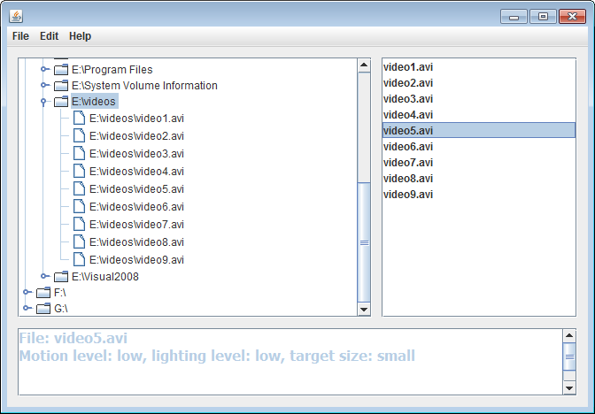
Quantifying Video Sequences (Automatically)
Target size: 70% accuracy,
Lighting level: 93% accuracy
Motion Level: planned
Reference application for practitioners, quantifying GUC (pending) – screenshot of user interface
Generalized Use Class
Choose Target Size
Choose Motion
Choose Lighting Level
Choose Discrimination Level
Choose Time Frame

Slide 8
Target Size
2 classes – large/small
Represents the sizes of appearing objects relative to frame dimensions
The larger side of objects bounding box is compared to the respective dimension of the frame. The threshold of “large” class is 0.4
Any object which has been large on the majority of frames it appears in, is classified as large. Otherwise it’s small.
General results for the scene is the one that applies to more objects

Slide 9
Lighting Level
Binary classification – high/low
The threshold of gray level is 55, when range is [0, 255]
Calculated for every objects as average luminance for every frame, as well as for whole frames
Objects are bright if they are bright for more frames than not
Final result – the class which more objects represent

Slide 10
Motion Level
Also 2 values – high and low
Not defined properly, therefore not implemented – results presented as undefined
When necessary, a dummy measure used: average magnitude of gradients in the temporal direction

Slide 11
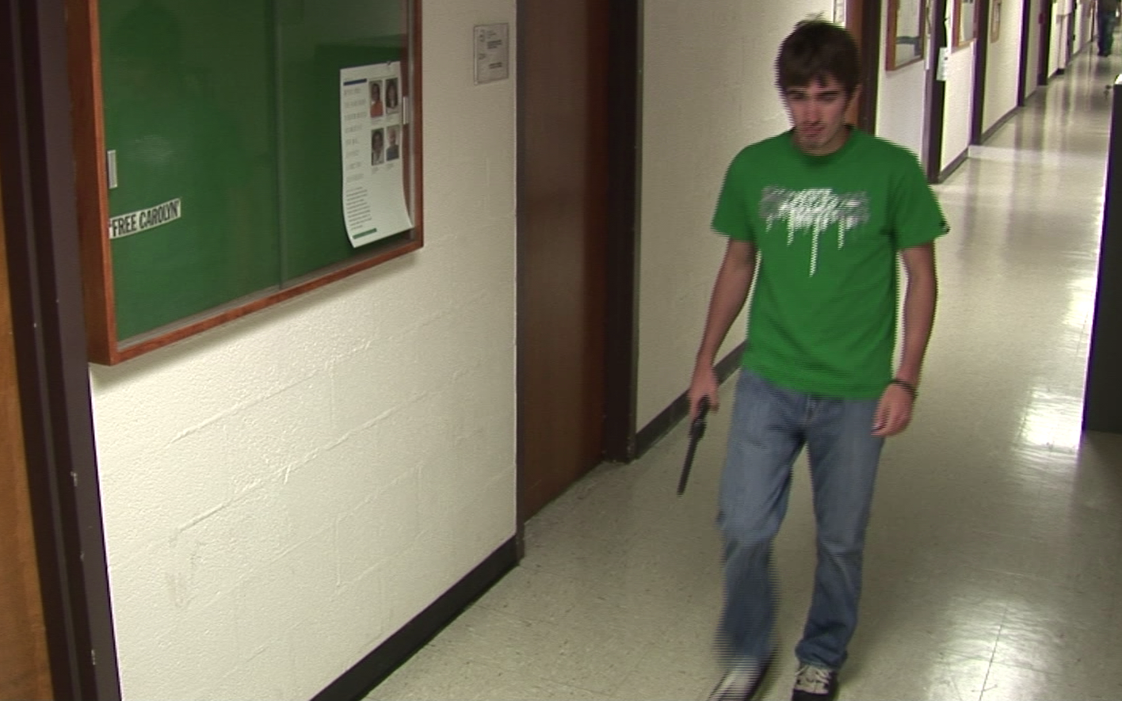
Example
The only moving object in this clip (person) would be classified as large
and bright. Consequently, this would be the class assigned to the scene.

Slide 12
Measuring Video Quality

Slide 13
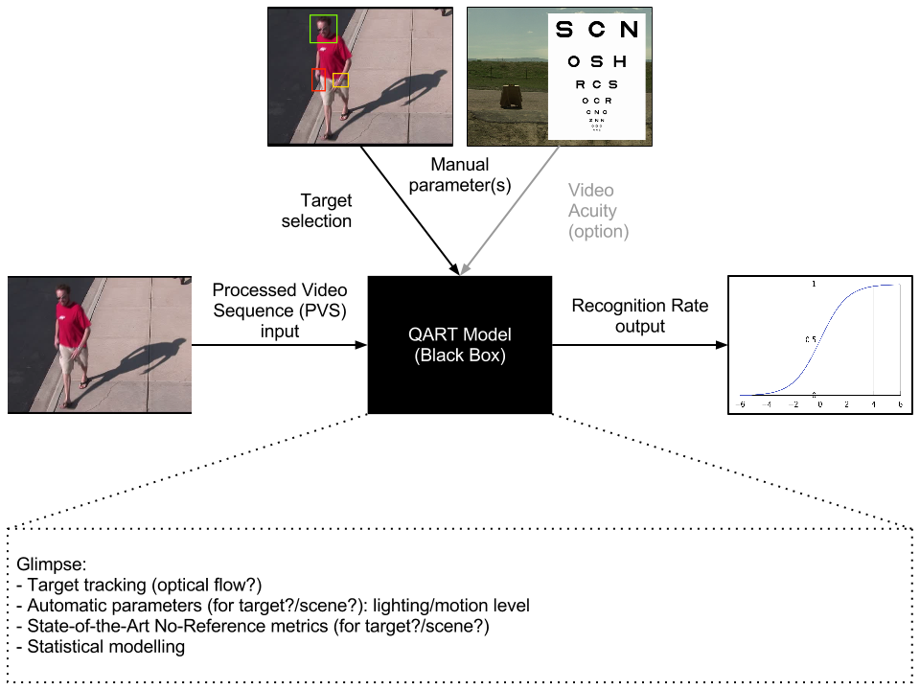
QART Model

Slide 14
Test sequence database
Goal: create database of object recognition results for collection of video sequences of differing quality
Store objective quality measures for each video
Check how well people discern specified visual information from video sequences
126 original video sequences – without artifacts (SRC)
130 HRCs
1860 derived clips (PVS)

Slide 15
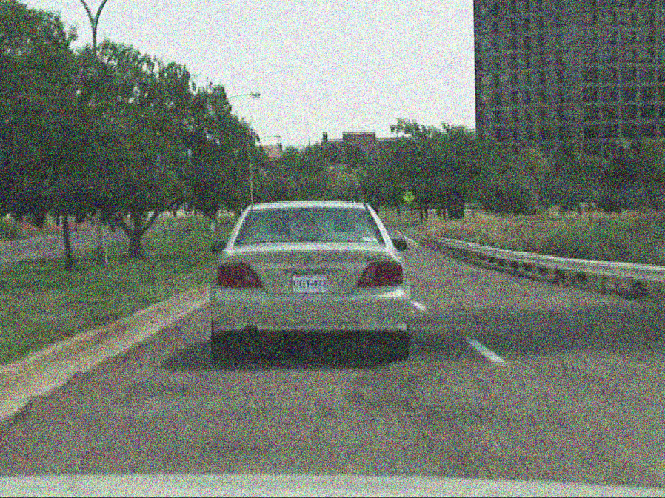
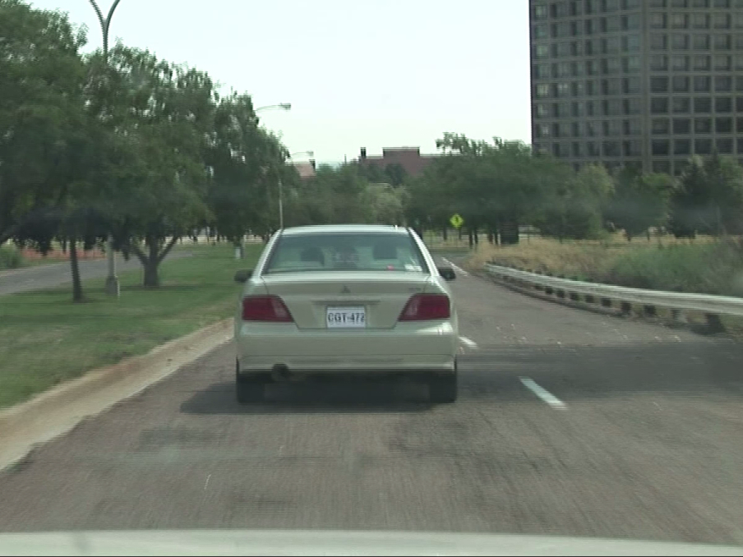

Many clips from each source
Every original scene is down-sampled, cropped or distorted in one of several ways to see how quality loss affects accuracy of target recognition
Source (SRC)
… and so on

Slide 16
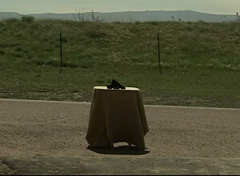
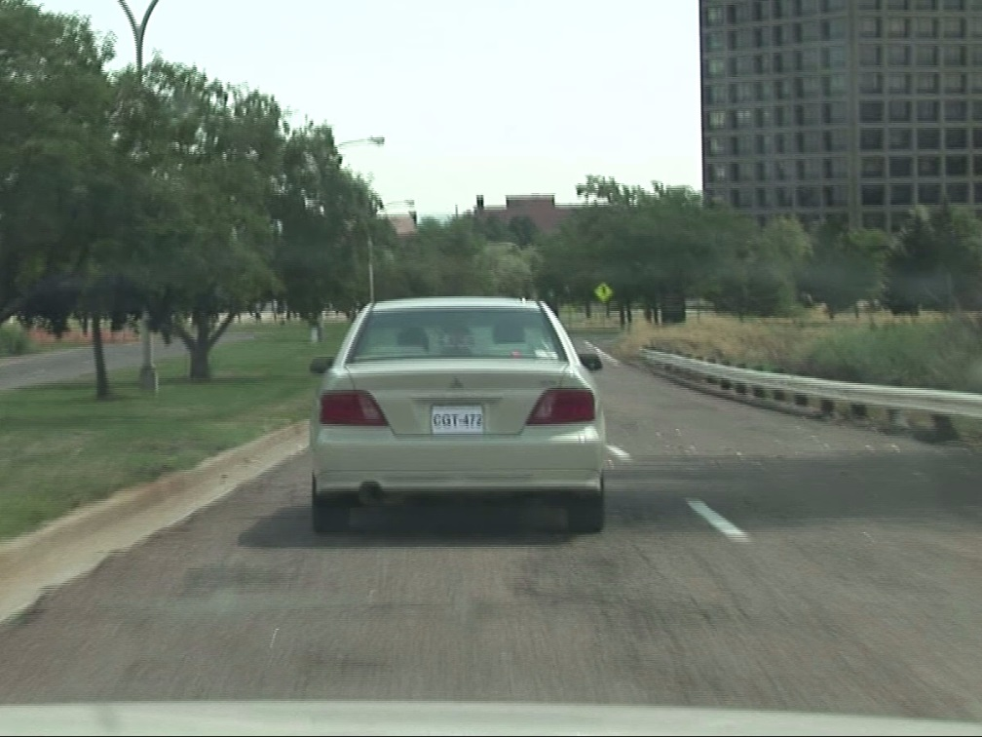
What are we testing?
For each clip human subjects were asked about specified information
Is it gun? Or phone? Or radio?
What is license number?
Target object
How many correct answers? How many wrong?

Slide 17
Target Tracking
Target object whose “recognizability” we are examining must be located in every moment throughout scene
It has to be marked by human user once in source sequence
Selection is stored as rectangle position and number of frame in which it was indicated
Bounding rectangles for other frames must then be obtained by object tracker in both time directions from that point

Slide 18
Parameters Calculated
Quality measures such as blur, noise, blockiness, interlacing, etc.
List should include enough parameters to enable finding conclusive statistical results
Each one computed for every frame
Stored separately for whole frames and for current target location

Slide 19
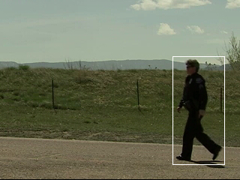

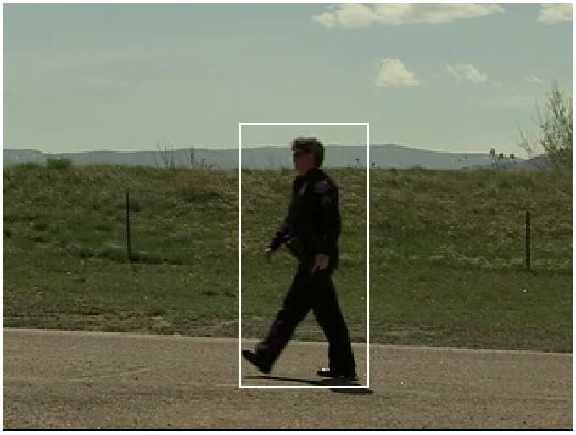
Quality parameters calculated for whole frame and for object being followed
Object selected
Pixels located in further frame
Following object in other frames

Slide 20
When Work Is Done…
Measures: noise, blur, …
m₁,m₂,m₃…m_{n}
Probability of recognition:
p(Correct)=f(m₁,m₂…m_{n})

Slide 21

Thank You – Questions and Discussion leszczuk@agh.edu.pl
Any comments???

