Slide 1

MOAVI at AGH
Conducted Studies & Demo
Mikołaj Leszczuk, Mateusz Hanusiak,
Ignacio Blanco
Faculty of Computer Science, Electronics and Telecommunications
Department of Telecommunications
Singapore, 12/12/2012

Slide 2
Presentation Plan
Carried out studies
Future plans
Demo of monitoring system
How does MOAVI work?
Downloadable metrics

Slide 3
Monitoring of Audio Visual Quality by Key Indicators (MOAVI)
Mission
  “To collaboratively develop No-Reference models for monitoring audio-visual service quality”
Goals
  To develop set of key indicators describing service quality in general
  To select subsets for each potential application
  To concentrate on models based on key indicators contrary to models predicting overall quality

Slide 4
Carried Out Studies

Slide 5
Conducted Studies
Signal-Based, No-Reference Metrics
Capturing Artifacts
Processing Artifacts
Transmission Artifacts
Displaying Artifacts

Slide 6

Blocking
Processing & Transmission Artifact

Slide 7
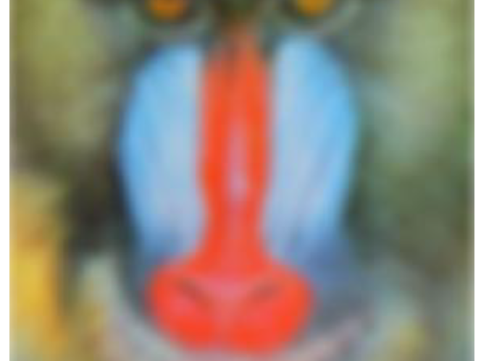
Blurring
Capturing, Processing & Transmission Artifact

Slide 8
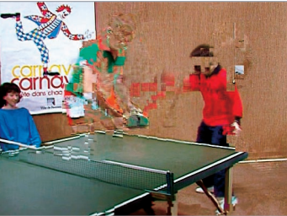
Ghosting
Capturing, Processing & Transmission Artifact

Slide 9
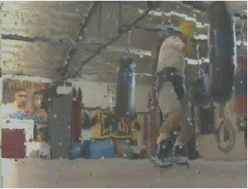
Block Missing
Transmission & Displaying Artifact

Slide 10
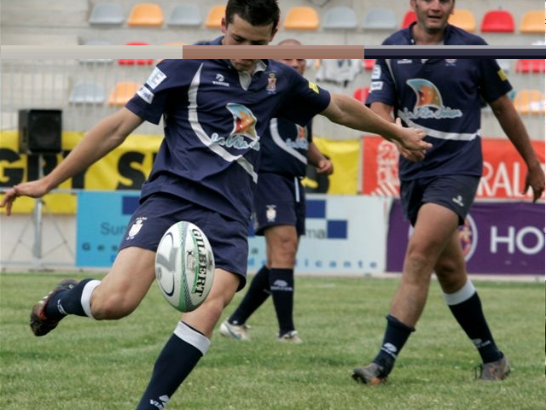
Stripe Noise
Transmission & Displaying Artifact

Slide 11

Color Bleeding
Processing & Transmission Artifact

Slide 12
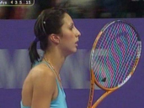
Rainbow Effect
Capturing Artifact

Slide 13
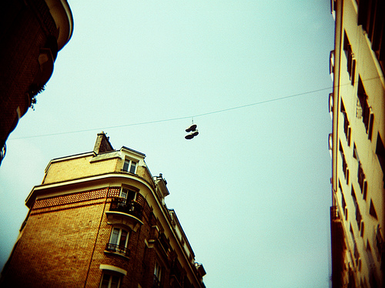
Vignetting
Capturing Artifact

Slide 14

Exposure time distortions
Capturing and Displaying Artifact

Slide 15
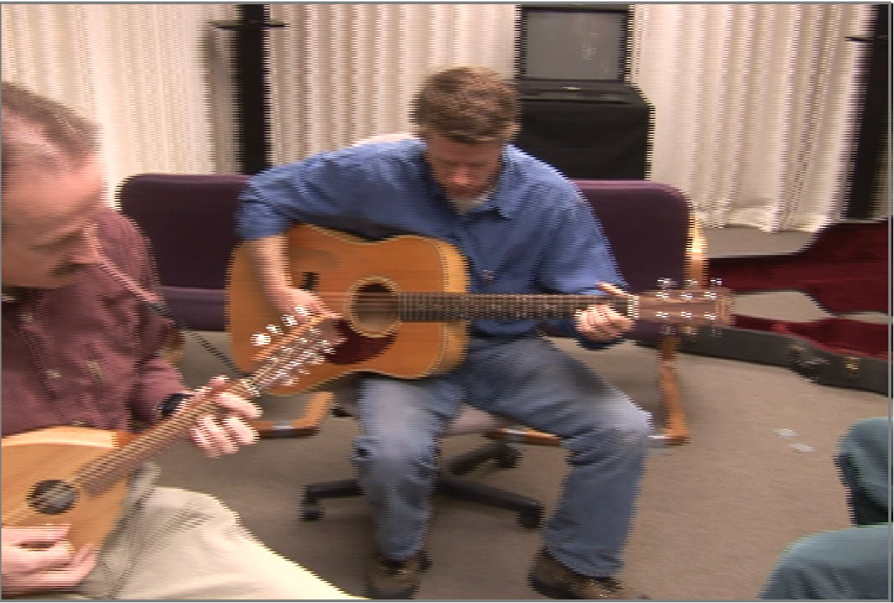
Interlace
Processing Artifact

Slide 16
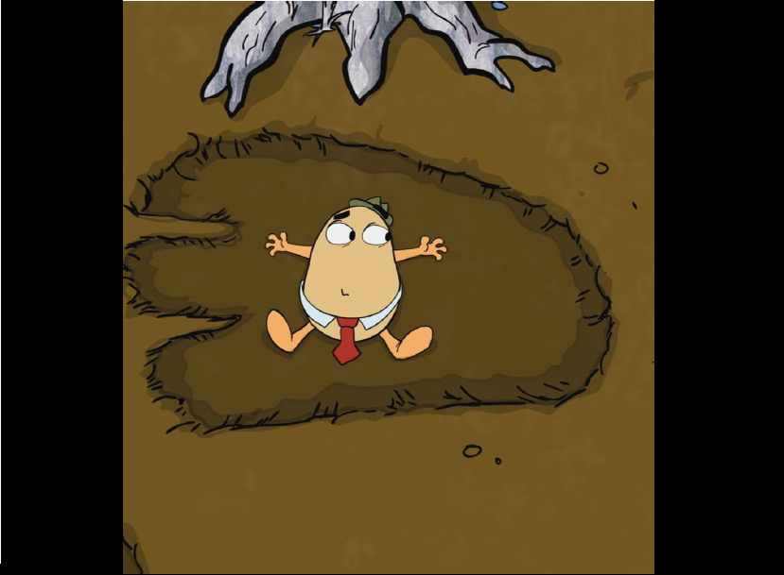
Pillar-boxing/Letter-boxing
Processing and Displaying Artifact

Slide 17
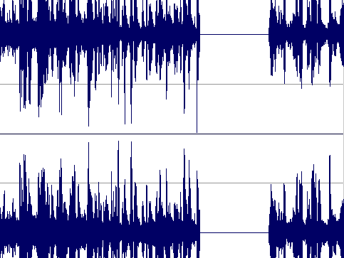
Mute
Capturing and Transmission Artifact

Slide 18
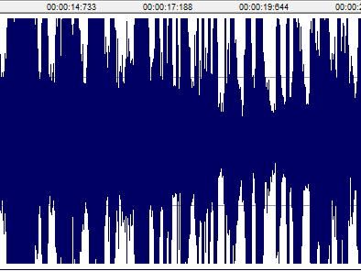
Clipping
Capturing, Processing and Displaying Artifact

Slide 19
HOW does MOAVI WORK?

Slide 20
Example 1 – Interlace Metric

Slide 21
Example 2 – Exposure Time Distortion Metric
MEAN & GREYSCALE
SORT

Slide 22
Example 3 – Block Missing Metric

Slide 23
Downloadable Metrics

Slide 24
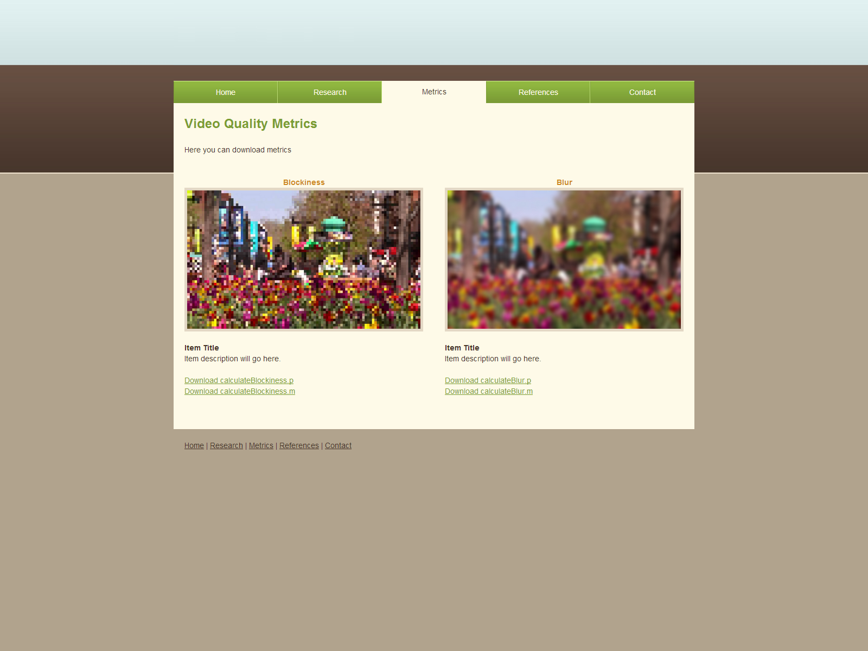
Downloadable MATLAB Functions
http://vq.kt.agh.edu.pl/ (under construction)

Slide 25
Demo of Monitoring System

Slide 26

Video: Example of Performance

Slide 27
Future PLANS

Slide 28

FUTURE PLANS
Work on new metrics:
  Epilepsy Flash Effects
  Lip sync
  Any other?
Study the dependence between artifacts
Develop Subjective Tests to obtain:
  Thresholds
  Feedback

Slide 29

Thank You – Questions and Discussion leszczuk@agh.edu.pl
Any comments???

