Slide 1
Proposal to study objective quality assessment of
4K resolution video in the future VQEG tests
Osamu Sugimoto
KDDI R&D Laboratories, Inc.

Slide 2
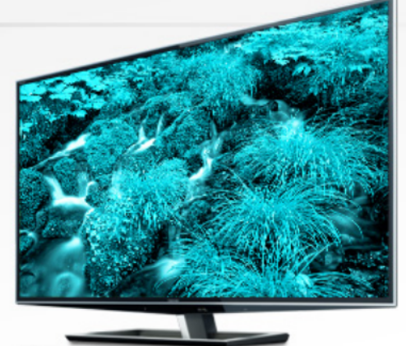
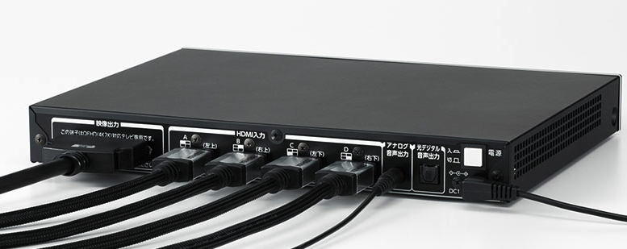

Backgrounds
4K video equipment in consumer market
  Monitor
    Toshiba began selling consumer grade 4K TV set in 2011. It supports input of QFHD video signal (3980x2160@60p; without super-resolution) with external 4xHDMI input box.
    Sony announced to launch their first consumer grade 4KTV set in the near future.
  Playback Device
    Some Graphics boards (e.g. AMD FirePro ) have four 1080p outputs and can display 4K/60p resolution on PC.
Storage and Compression
  BDXL: Extended specification of Blu-ray
    Supports 100 and 128GB per one disk
  HEVC video coding
    Better coding efficiency than that of H.264
Toshiba 4K2K TV set; (~7000USD)
External QFHD Adapter(~2000USD)
4K video will be more popular and industry needs will also increase in the near future
4K Graphics Board (~1200USD)

Slide 3
Proposal
VQEG should include quality assessment of 4K video into the scope of future VQEG tests.
  Subjective test methodologies for large display/screen (50-100inches)
  Objective metrics for quality degradation due to compression coding and transmission
SRC definition
  4K DCI for digital cinema (4096x2160@24fps, progressive)
  4K-QFHD for broadcasting applications (3840x2160@24,25,30,50,60fps, progressive)
HRC to be considered
  H.264
  HEVC
  Intra coding for digital cinema (e.g. JPEG2000) ?

Slide 4
SRC Availability
NICT 4K/3D contents
  Format: 3840x2160@60fps.
  NTT introduces guidelines to use this test material.
  ftp://vqeg.its.bldrdoc.gov/Documents/VQEG_Seoul_Jun11/MeetingFiles/3DTV/VQEG_3DTV_2011_015_Distribution of 3D standard contents.doc
SVT High Definition Multi Format Test Set
  Format: 3840x2160@50fps.
  You can download them from the VQEG ftp server.
  ftp://vqeg.its.bldrdoc.gov/HDTV/SVT_MultiFormat/2160p50_CgrLevels_Master_SVTdec05
  For details, see the following documents.
  http://svt.se/content/1/c8/02/02/85/31/svt_multiformat_v10.pdf
DCI/STeM
  Maximum resolution of the test sequence is 4096x1714.
  You need to sign the user agreement.
  http://www.dcimovies.com/StEM

Slide 5


Subjective test of 4K+HEVC
Test method: DSCQS
Viewing Conditions
  Display: professional 4K projector (JVC)
  Screen size: approx. 190inches
  Viewing Distance: 1.5H (H=screen height)
Number of subjects: 24
Test materials
  14 sequences of 10 sec from KDDI’s own 4K footages
  Format: 3840x2160,30fps, progressive
Coding Condition
  H.264(JM15.1): 8,16,32Mbps (IBBPBBPBBPBBPBB)
  Rate control enabled
  HEVC(HM6.1) : 4,8,16Mbps (IBBBBBBBBBBBBBB)
  Fixed QP

Slide 6
Subjective test of 4K+HEVC
35% of all the HEVC PVSs have better DMOS than those coded by
H.264 at twice bitrate.
54% of all the HEVC PVSs have better (smaller) DMOS than those coded by H.264 at the same bitrate.

Slide 7
Conclusion
As 4K will possibly be a part of the mainstream of future video formats, VQEG should begin to study on quality assessment of 4K video.
The HDTV phase2 test seems to be a good opportunity of the first study, but the opportunity is not limited to that. Any other VQEG tests may include 4K into its scope.

