Slide 1
Video Quality for Public Safety Applications
Margaret Pinson
Public Safety Communications Research
U.S. Dept. of Commerce
June 6, 2011

Slide 2
Public Safety Communications Research Program
VISION
Public safety pracitioners
Police
Firefighters
Emergency Medical Services
Seamless exchange of voice, video and data to effectively respond to any incident or emergency
By encouraging the development and adoption of critical standards
Notes:
Branding undertaken in 2008

Slide 3
PSCR Portfolio
LMR Standards and Technologies | Broadband Standards and Technologies | Interoperability Device Standards and Technologies | Emerging Standards and Technologies | Cross-cutting or Supporting Activities
P25 CAP | 700 MHz Broadband | Multi-Band Radio | P25 Security | Program Management & Reporting
Project 25 (P25) Standards Development | Public Safety VoIP | Interim Interoperability Device Testing | Technical Services Projects | Statement of Requirements (SOR)
ISSI Test Tools | 4.9 GHz Broadband Task Group |  | Video Quality | Public Safety Architecture Framework
Audio Quality | ROW-B |  |  | RF Propagation Studies
 | Modeling and Simulation
Notes:
3

Slide 4
Video Quality
Our goal is to develop recommendations for public safety practitioners
  Minimum requirements to meet their needs
What is quality in public safety applications?
  MOS is not appropriate for public safety
  Video must be useful—we have taken a task-based approach
  Preliminary tests have been conducted on the object recognition task

Slide 5
The Object Recognition Task
The object recognition task is common across public safety applications
  Different applications may have similar requirements
Scene content parameters:
  Lighting conditions
  Level of motion
  Target size
Scenes with equivalent values for these parameters form a “scenario group”
Use cases with equivalent parameters for a “generalized use class”

Slide 6
The Test
Quality is greatly impacted by the bitrate of compressed video
We wish to understand the interaction between scene content parameters and bitrate
Scenes from a variety of scenario groups with a variety of target objects were created, processed at different bitrates and presented to viewers who were asked to perform a recognition task

Slide 7
Test Details
Scene content parameters
  Lighting: Outdoor, bright, dim w/ flashing, flashing only
  Motion: Stationary, walking speed
  Target Size: Small, large
Items: Gun, taser, radio, flashlight, cell phone, mug, soda
Processing parameters (HRC’s)
  Resolutions: CIF, VGA
  Bitrates: five choices for each resolution
  All clips were encoded with H.264, baseline profile

Slide 8
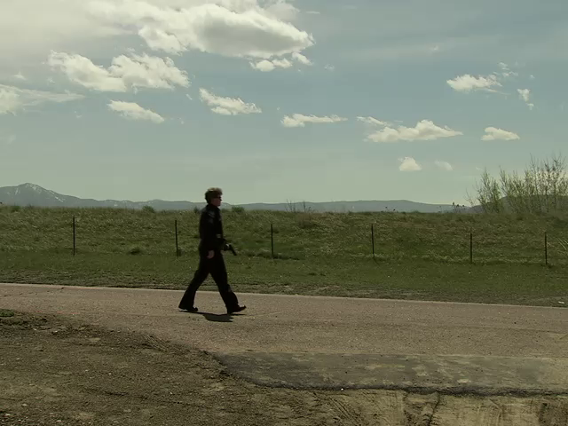
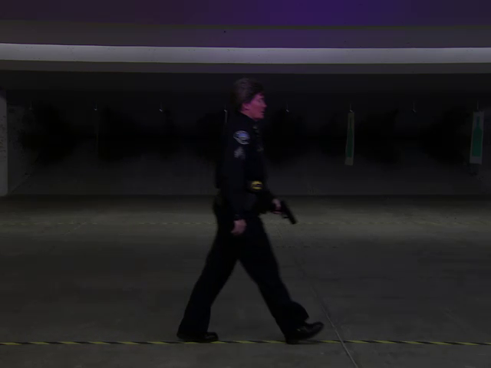
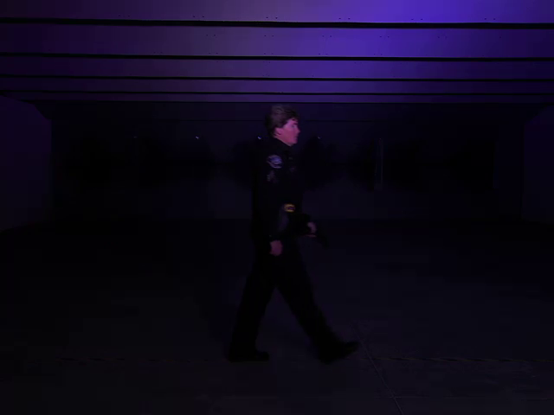
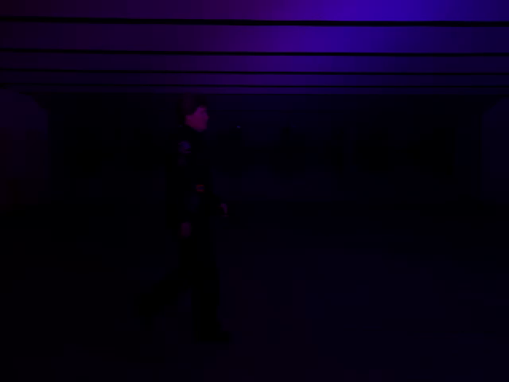
Lighting Examples
Outdoor
Bright
Dim w/ Flashing
Flashing Only

Slide 9
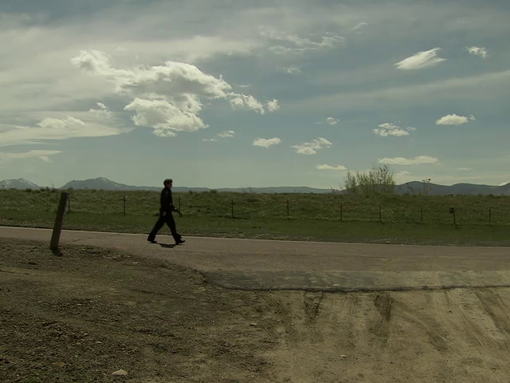
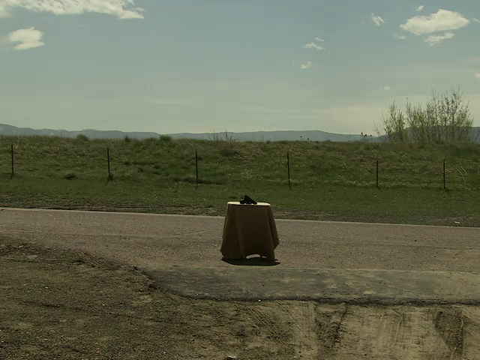
Motion and Target Size Examples
Walking, Large Target
Walking, Small Target
Stationary, Large Target

Slide 10
More Test Details
For a given scenario group, scenes were held constant
  Only the target object changes
  Avoid memorization
Methods described in ITU-T Recommendation P.912
Collected data from 37 viewers, all public safety practitioners

Slide 11
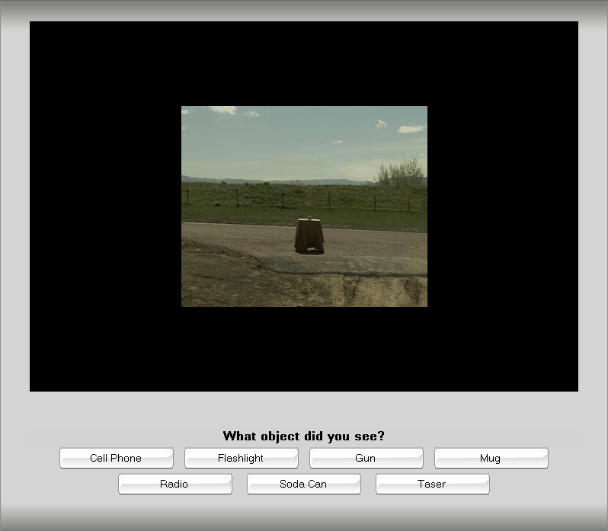
Test Example
Forced Choice

Slide 12
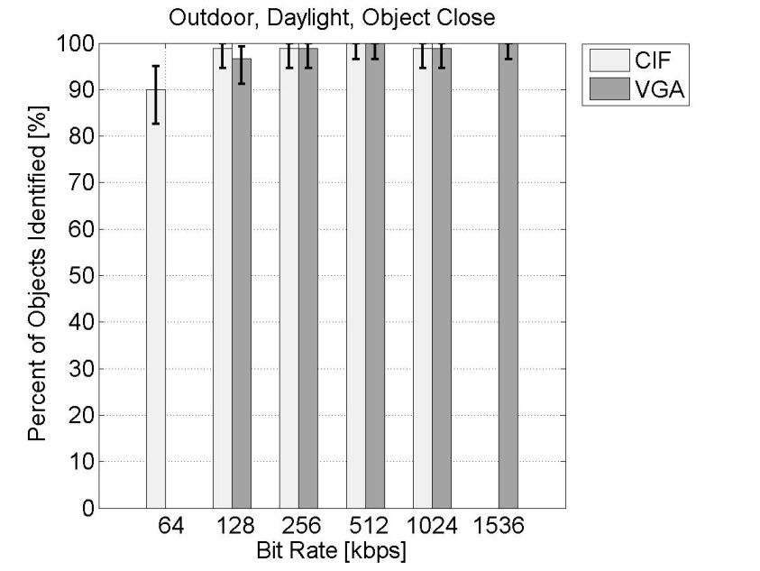
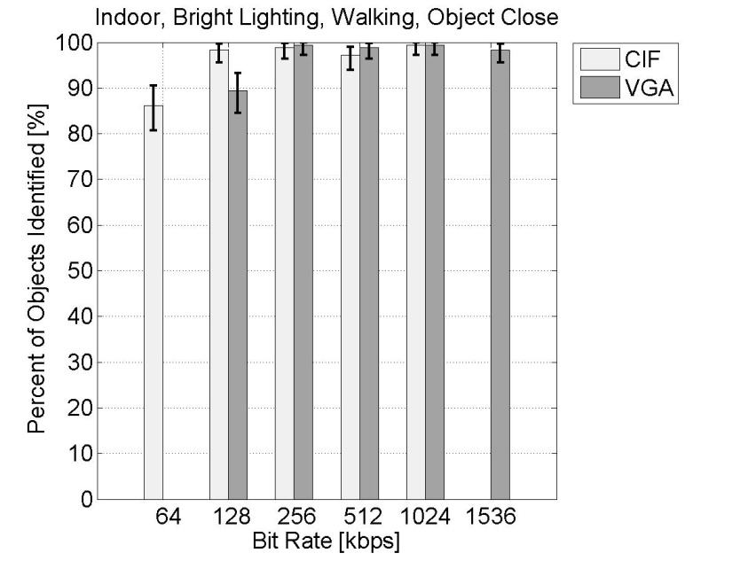
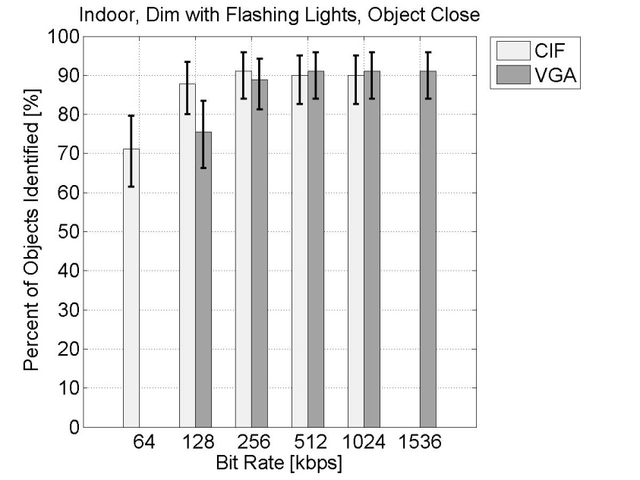
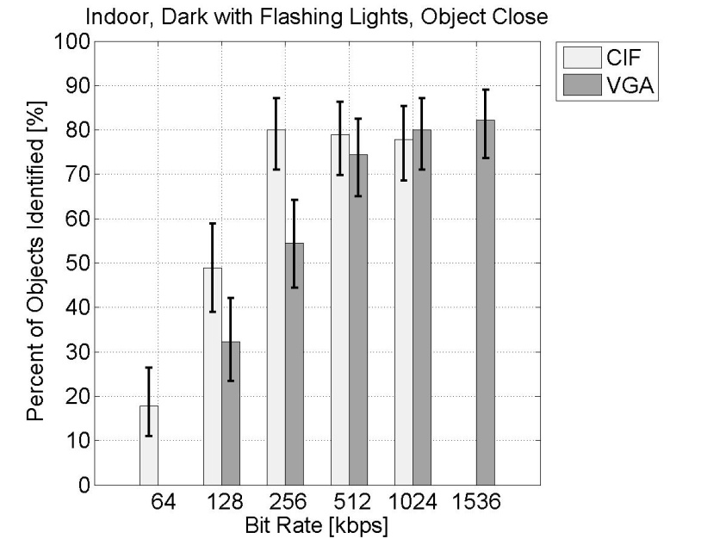
Results: Lighting
Daylight
Bright
Dim with Flashing
Flashing Only

Slide 13
Results: Lighting
Previous slide shows stationary, large target data
We had hoped to be able to specify the bandwidth required for a given recognition level for each scenario group
Saturation effect
  Under poor lighting conditions, increasing bandwidth does not always increase recognition performance
  Outdoor and bright indoor lighting are good enough, dim lighting is not
CIF outperforms VGA in poor lighting
  Easier to cope with flashing lights?

Slide 14

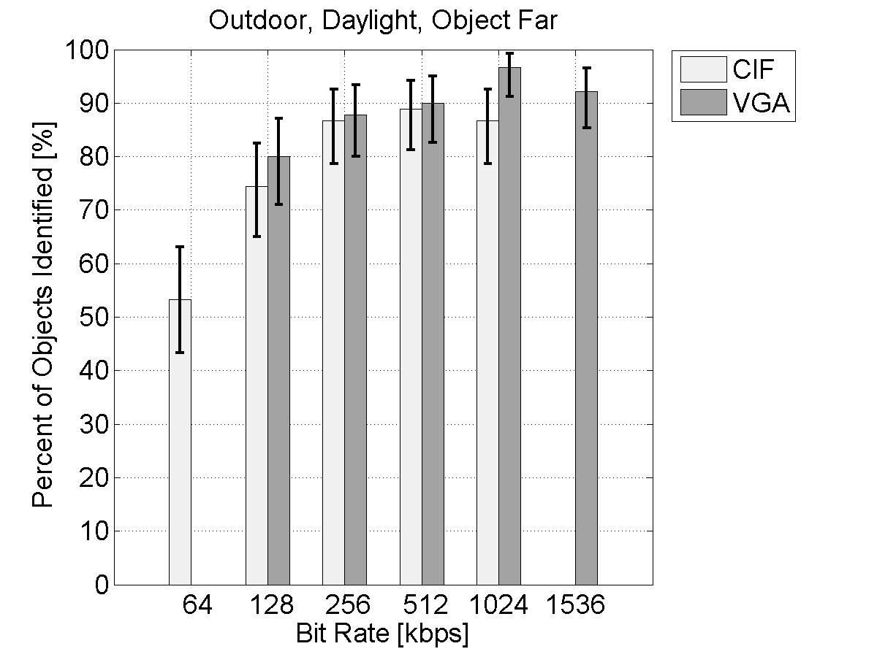
Results: Target Size
Large Target
Small Target
These are outdoor, stationary data
Similar saturation effect

Slide 15
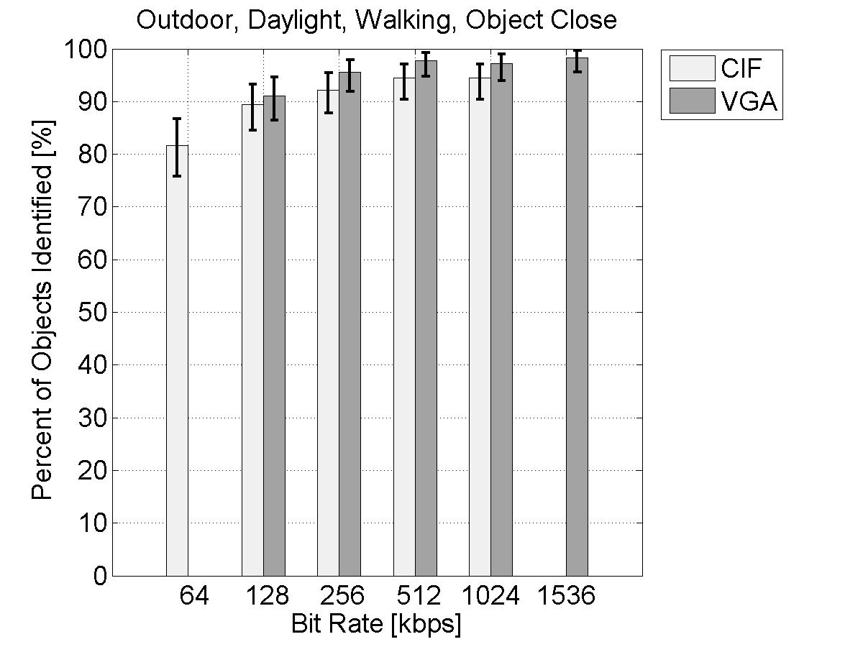
Results: Motion – Large Target
Stationary
Walking Speed
These are outdoor, large target data
  Relatively small impact with large target

Slide 16
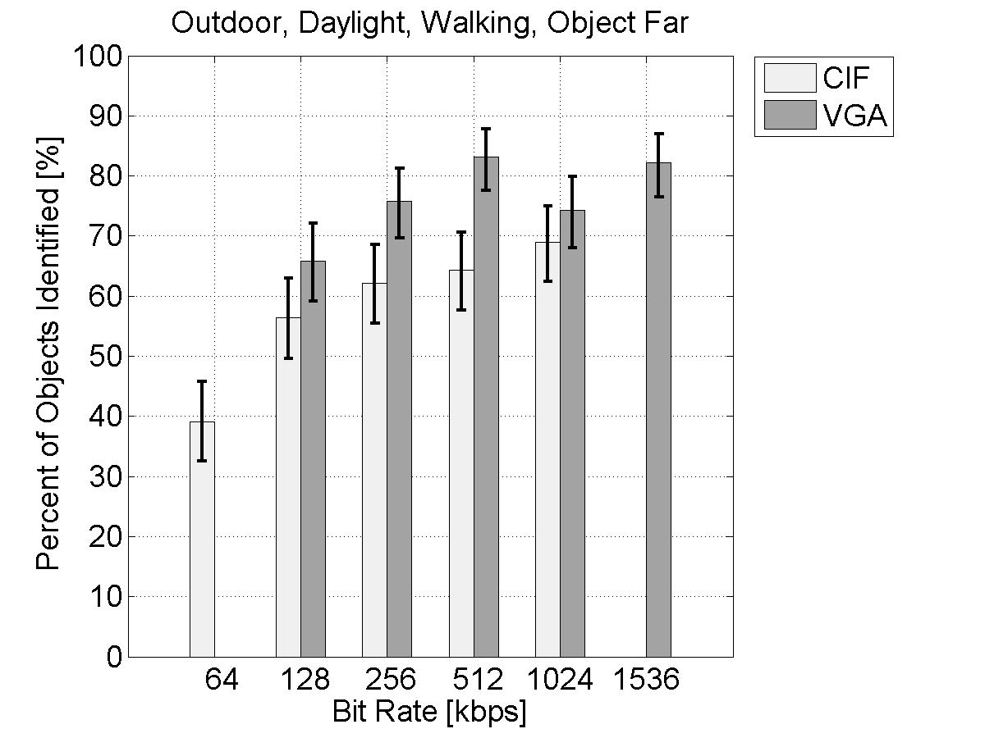
Results: Motion – Small Target
Stationary
Walking Speed
Much more significant impact with small target
  Non-linear
Motion also degrades performance in poor lighting
VGA better than CIF

Slide 17
Resolution
CIF is better under poor lighting conditions
VGA is better with motion
VGA is not significantly better than CIF for a small target
  Suggests CIF meets the minimum resolution required to discern our small targets
  Clearly, further study would be beneficial

Slide 18
Conclusions
Coding isn’t everything
More resolution isn’t always better
More work is required on automatic classification of scenario groups
Under the right conditions, extremely low bitrates can still be useful

Slide 19
Future Work
Each of the scene parameters from this test should be studied separately, in depth
There are additional parameters that determine a “generalized use class” (GUC) in the VQiPS user guide
  Recorded vs. live video
  Discrimination level
    e.g., general elements of the action, classification, positive identification
  We will explore these two dimensions in three phases of testing

Slide 20
Future Tests – Phase 1
Very similar to previous test
  Recorded video instead of live
  Viewers will be allowed to pause the video and step through frames
  Viewers can replay each clip as many times as desired before selecting an object
Data is currently being gathered for this phase

Slide 21
Future Tests – Phases 2 and 3
After Phase 1, we will have explored every dimension of the GUC’s except for discrimination level
We will use the idea of acuity to extend our previous results along this dimension

Slide 22
Acuity
Acuity is intended to be a one-dimensional measurement that describes the usefulness of a video system for recognition tasks
Acuity will likely be measured in terms of a viewers ability to recognize characters on something similar to a Snellen chart.
If we can map recognition rates to acuity and develop acuity requirements for each discrimination level, the data we have collected will allow us to make recommendations for every GUC.

Slide 23
Future Tests – Phase 2
The purpose of this test is to measure the relationship between acuity and object recognition rates
We will use video content similar to our previous tests, but charts for measuring acuity will be included in each scene.
Viewers will be asked to recognize objects and read charts

Slide 24
Future Tests – Phase 3
The purpose of this test is to measure acuity requirements for each discrimination level
New video content for this test
  Will include the acuity charts
  Will be suitable for questions about various levels of detail
Viewers will be asked to read the charts
Viewers will be asked progressively more difficult multiple choice questions about scene content
  When a viewer answers incorrectly the test will advance to the next scene

Slide 25
Video Quality in Public Safety (VQiPS)
Bring people together
  Police, fire fighters, emergency medical, public transit, manufacturers, government, universities
Learn what video quality means for public safety practitioners
Express in technical terms
  Requirements
Common ground for different jobs
  Application independent use classes
Voluntary

Slide 26
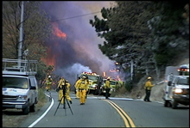
VQiPS Motivations
Practitioners rely on video technology to keep people safe
  Poor quality video quality can mean the difference between life and death
Give practitioners the tools, support and information to make informed purchasing decisions
First responders at wildfire scene. Tactical video can help incident controllers.
Unbiased guidance

Slide 27
Video Quality in Public Safety (VQiPS)
Outputs
  User guide
  Web tool
  Glossary of terms
  Find existing standards
  Library of test video sequences

Slide 28
Questions?
Joel Dumke
jdumke@its.bldrdoc.gov

