Slide 1
Impact of Lab Effects and Environment on Audiovisual Quality
Margaret H. Pinson

Slide 2
Goal
Investigate interactions:
  Testing Laboratory
  Experiment Environment
  Audiovisual Quality MOS
Preliminary
  Small test – what we can do easily
  Insights – learn scope of problem
  Help design follow-on experiments
Do what is easy
  Run subject with another subjective experiment
  Use environment have available

Slide 3
Questions
How repeatable are audiovisual subjective tests from lab to lab in a pristine environment (e.g., ITU-R Rec. BT.500, ITU-T P.911, sound isolation room)
How are critical are the currently agreed upon pristine environmental constraints? For example, what if a quiet room is used instead of a sound isolation room?
How are audiovisual MOS impacted by conducting the experiment on location (e.g., in a cafeteria or at a café).
Is data from red-green colorblind people is indistinguishable from other subjects?
What is the impact of language on MOS? For example, English speech with subjects who are not fluent in English.

Slide 4
Design
Small VGA Subjective Test
  10 SRC
  5 HRCs + original
  Three audio impairment levels (original, fair, bad)
  Three video impairment levels (original, fair, bad)
Multiple VQEG Testing Labs
Different Environments
  Pristine Lab
  Good Lab
  On Location – cafeteria, bus stop, home, park

Slide 5
Design
Source Video
  2 music video
  2 simulated news with background noise
  Choreographed band on grass field
  Boxing demonstration
  Unprofessional musicians
  2 animation
Test Software
  Lightly compressed clips
  Reliable playback on any computer
  ACR

Slide 6
NTIA Environment - Laboratory
Pristine Laboratory
  Sound isolation booth
  Compliant with P.800 noise levels
  Compliant with ITU-R BT.500
  Professional grade LCD television
  Professional grade speakers
  27 Subjects brought in for a different experiment
Noncompliant as follows:
  Speakers behind subject
  No backlighting
  Light color temperature close but not exact
  Monitor calibration for LCD (not CRT)

Slide 7
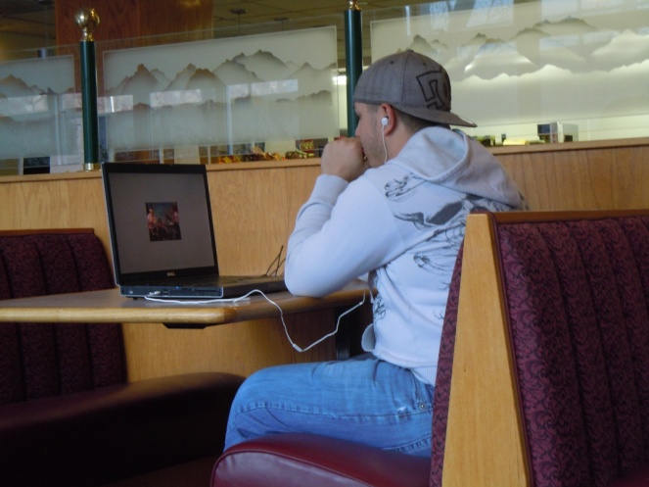
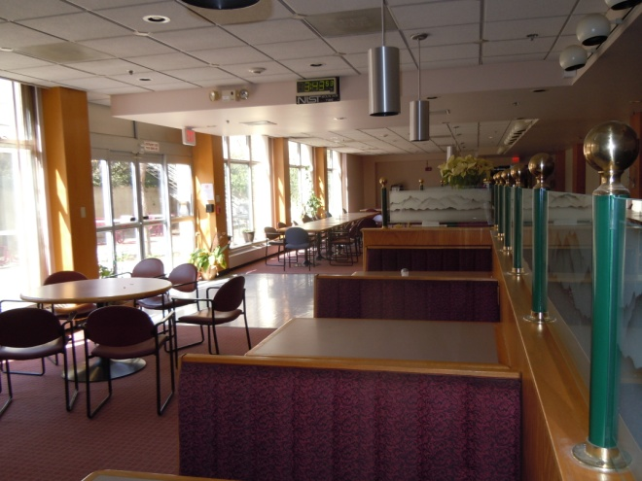
NTIA Environment - Cafeteria
Office cafeteria
  Soft music plus noise from cafeteria patrons
  Natural light plus fluorescent light
  Laptop with ear buds – 1920x1200 resolution screen
  Manufacturer default video levels
  12 subjects

Slide 8
NTIA Environments – 0.95 Correlation

Slide 9
Can you run subjects?
CD with everything you need
Goal – repeat test in a variety of environments
  Pristine lab
  Nearly pristine lab
  Close to pristine (e.g., BT.500 but not P.800)
  Simulated location
  On location
Want subjective data by end of July
  Paper by end of September

