Slide 1
VQEG 3D TV Session 8th June 2011
SID ’11: 55.3: Crosstalk Measurements of Shutter Glasses 3D Displays
Marcus Barkowsky¹, Sylvain Tourancheau², Kjell Brunnström³,
Kun Wang^{2,3}, Börje Andrén³
¹ IRCCyN, Polytech’Nantes, University of Nantes, 44306 Nantes, France
² Dept. of Information Technology and Media, Mid Sweden University (MIUN), 85170 Sundsvall, Sweden
³ NetLab: IPTV, Video and Display Quality, Acreo AB, 16440 Kista, Sweden
Notes:
Thank you Mr Chairman. This work was a collaboration between the University of Nantes in France, Mid Sweden University and Acreo in Sweden.
Did you know that there are a strong influence on the crosstalk depending on what is shown in the other view? We will show measurement results that shows that

Slide 2

Introduction
Motivation:
Crosslab measurements of crosstalk in preparation for a user experience experiment planned within the Video Quality Experts Group (VQEG), www.vqeg.org
Define measurement method that are reproducible from lab-to-lab

Slide 3
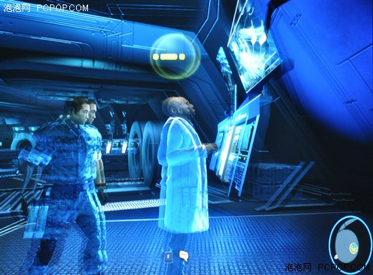
Introduction
Crosstalk:
The electrical or optical mixing of left- and right-eye image channels
Highly influential factor on 3D quality and comfort
This study:
Crosstalk on shutter glasses displays
  Continuous temporal measurements
  Averaging luminance measurements

Slide 4
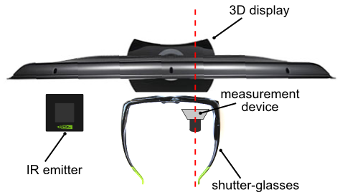
  Continuous temporal measurements
NVIDEA 3D vision
Sensor Burr-Brown OPT101 monolithic photo-diode
Response time 28 µs
Recording with oscilloscope, sampling rate 50 kHz

Slide 5
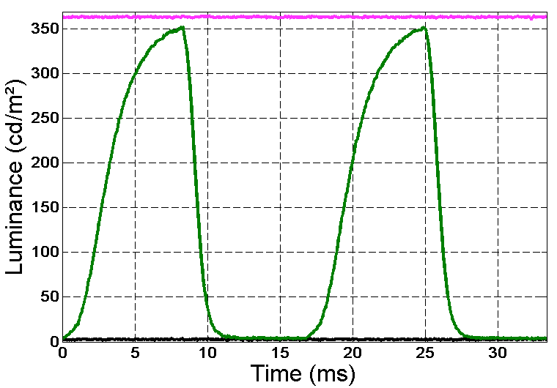
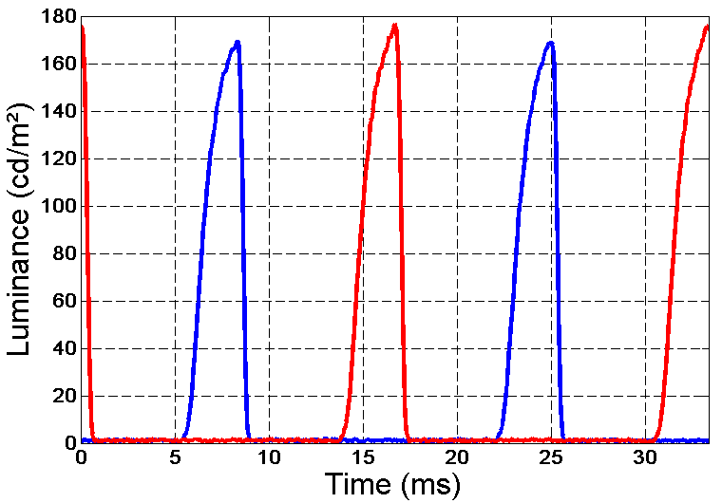
  Continuous temporal measurements
On display
White-white
White-black (Left: 0 Right: 255)
Black-black
Through Eye-glasses
Opening eye-glasses synchronized to the end of the display frame period
Opening is short just about 2,6 msec (half height)
Left: 0 Right: 255
Measured Right
Left: 255 Right: 0
Measure Left

Slide 6
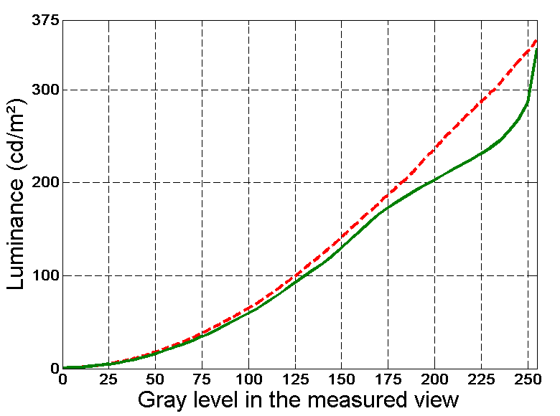
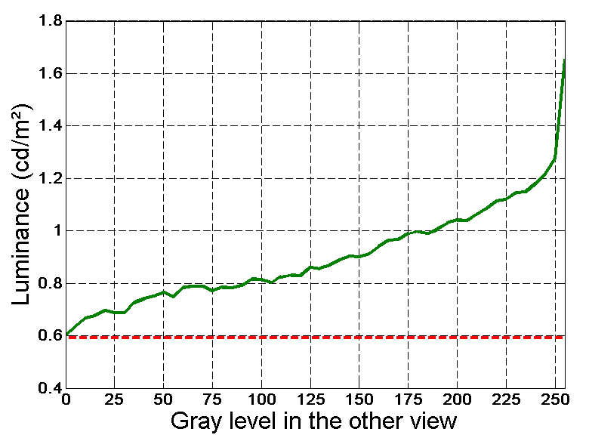
Continuous temporal measurements
On display measurements (average taken the last 3 ms of display period)
Luminance ramp in both views (red curve)
Luminance ramp in view1 and black in view 2 (green curve)
Average of view1
Black in both views (red curve)
Black in view1 and luminance ramp in view 2 (green curve)
Average of view1
Grey-grey
Grey-black
Black-black
Grey-black
Note! Displayed luminance highly dependent on what is displayed in the other view

Slide 7
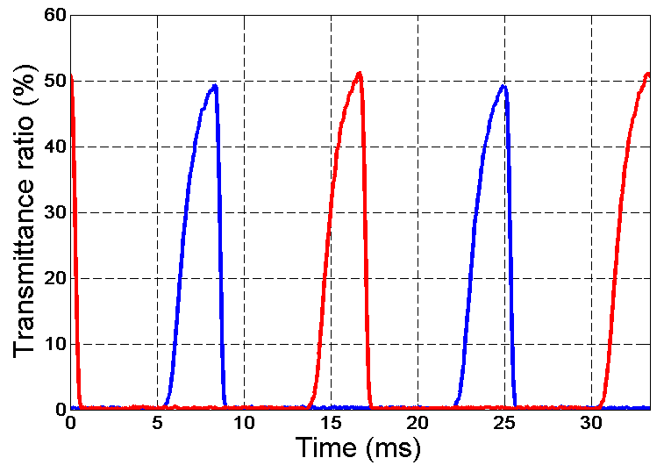
Temporal transmittance
Ratio of the incoming light with light passing through the eye-glasses
Time average
  Opened: 12.2% (right), 12.7 (left)
  Closed: 0.23% (right), 0.25% (left)
Right
Left

Slide 8
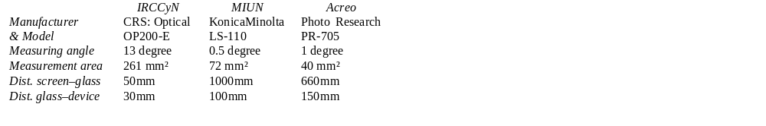
Time average measurements
Two types of displays were measured in three labs
  Alienware Optx AW2310 (1920x1080 pixels) (three different samples)
  Samsung SyncMaster 2233RZ (1680x1050 pixels) (two different samples)
  Three different samples of eye-glasses (one in each lab)
Different measurement instruments were used:

Slide 9
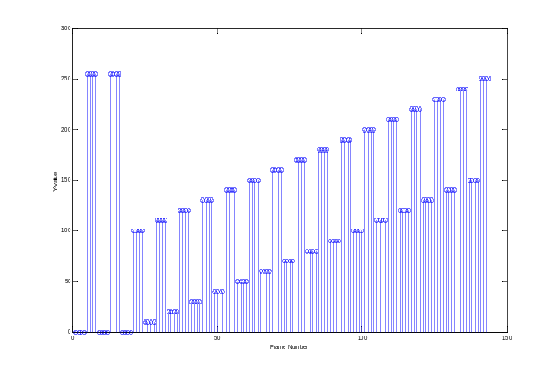
Method
Three different types of stairstep sequences
  SEQ1: Left and right same (Y = 0, 90, 15, 105, 30,…, 120, 255)
  SEQ2: Right fixed (Y=0 and Y=80) Left stairstep
  SEQ3: Left fixed (Y=0 and Y=80) Right stairstep
Measurements
  SEQ1 without eye-glasses
  SEQ1, SEQ2 and SEQ3 through left eye-glass
  SEQ1, SEQ2 and SEQ3 through right eye-glass

Slide 10
Crosstalk calculations
Three luminance sources
  From signal (desired luminance)
  Leakage from other view (crosstalk)
  Background luminance
Crosstalk as multiplicative factor
Vector of Crosstalk values for left (SEQ2) and right view (SEQ3)

Slide 11
Crosstalk results
 | Alienware |  | Samsung
 | left | right | left | Right
IRCCyN | 6.8‰ | 7.9‰ | 6.4‰ | 5.6‰
MIUN | 4.5‰ | 6.2‰ | 6.2‰ | 4.9‰
Acreo | 4.2‰ | 4.3‰ | 4.5‰ | 3.1‰
Mean values over stable range i.e. grey 105 to 255
Same range for all estimated crosstalk
Note: Difference between left and right
Note: Difference between Lab

Slide 12
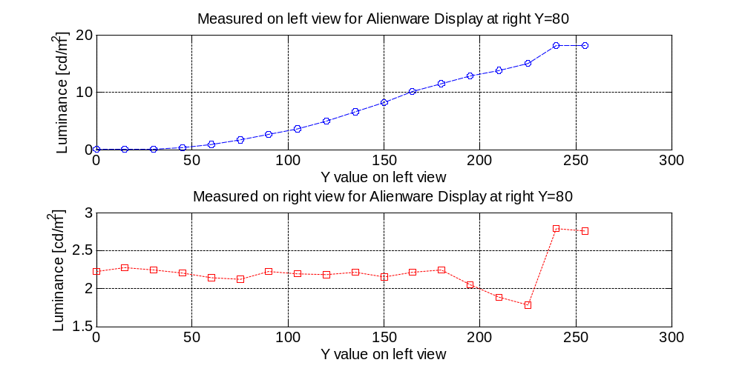
Crosstalk results

Slide 13
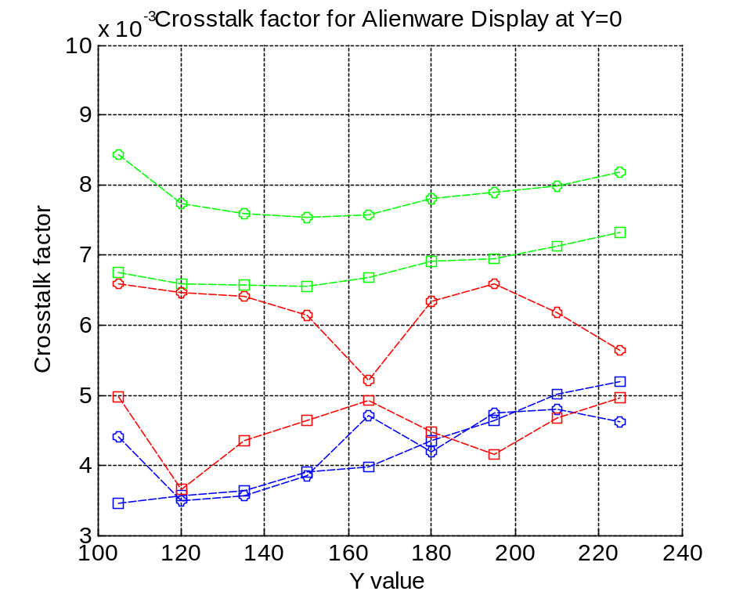
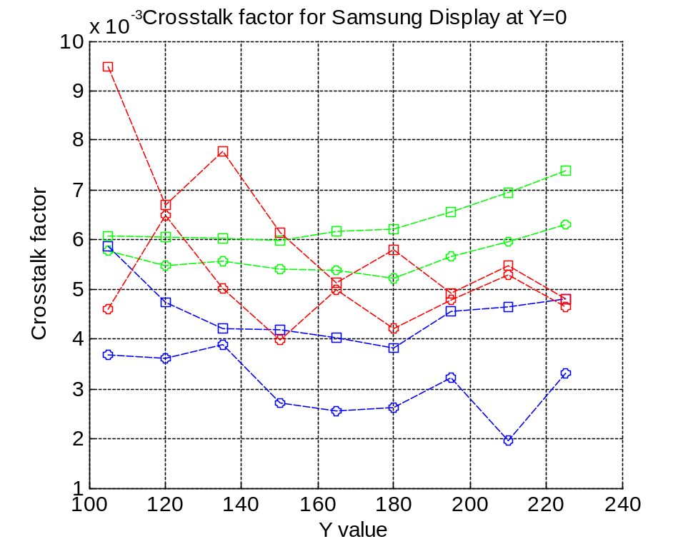
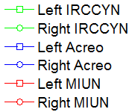
Crosstalk results

Slide 14
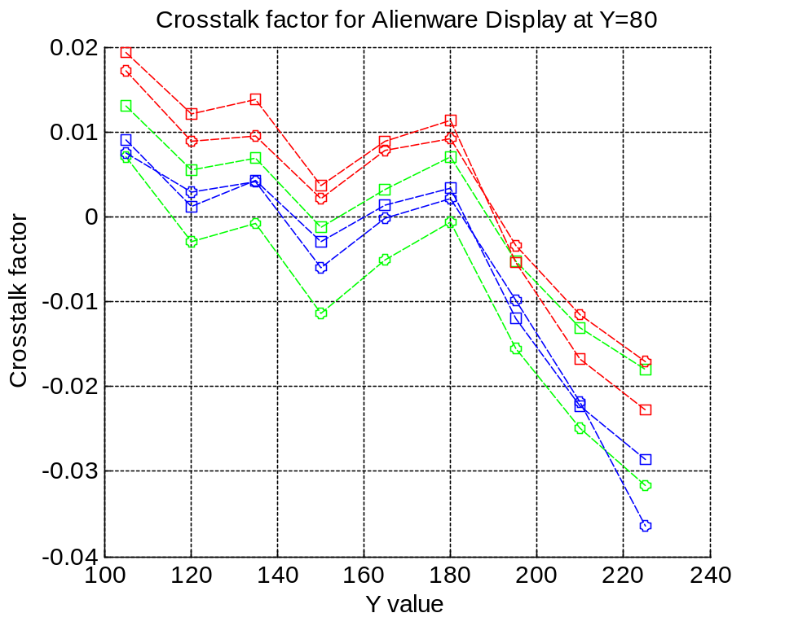
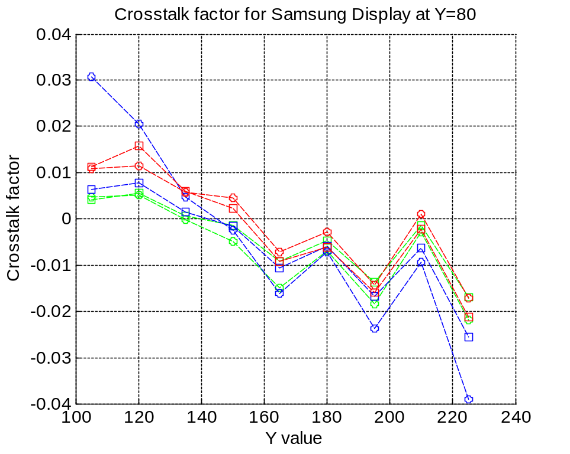
Crosstalk results
Note! The negative crosstalk for higher luminances

Slide 15
Summary & conclusion
Main purpose to define measurement method that are reproducible from lab-to-lab
There are differences between the labs and between the eye-glasses, but in the same range.
This may be due to different measurement instrument used, but also different eye-glasses and display samples
Low luminance measurements (black) is also difficult, which increase the spread between the labs
Both temporal and time average measurements shows that the grey level in the other view is important, so the measurements should be done for several greylevels
We have got an idea on the variation we could expect when planning the crosstalk user studies within VQEG
Work is in progress to investigate the problem further

Slide 16
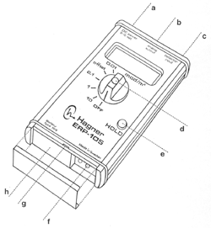
Hagner Photometer ERP-105
Measurement range: 0.0001-20 cd/m²

Slide 17
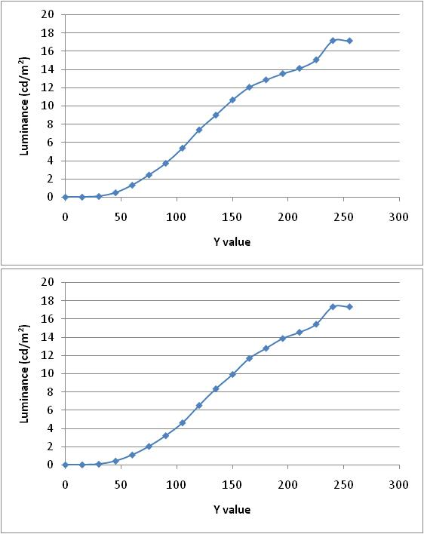
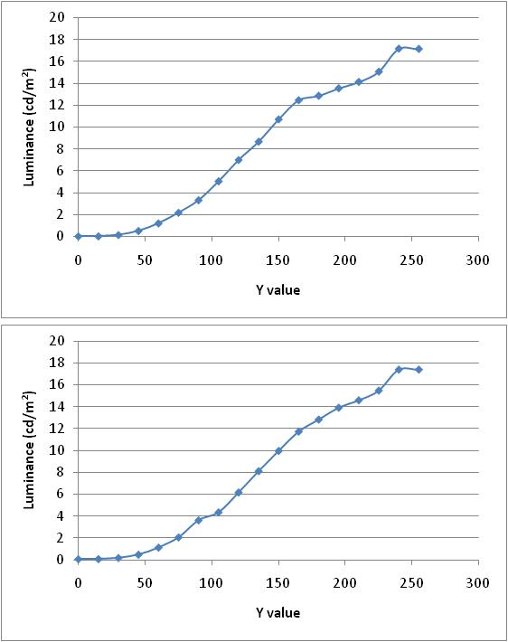
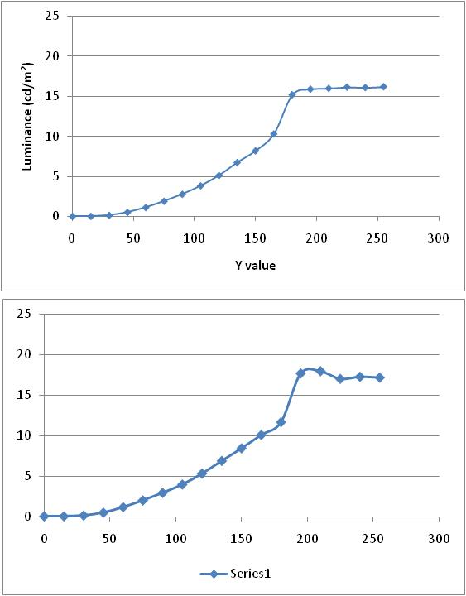
Sequence 3, Right Ramp while Left view Y=0 / 80, Measured at Right view after glasses
Center of display
Measurement 1 (PR-705)
Center of display
Measurement 2 (Hagner E4-x)
Center bottom of display
Measurement2 (Hagner E4-x)
Top figure Y=0 in Left view, down figure Y=80 in Left view

Slide 18
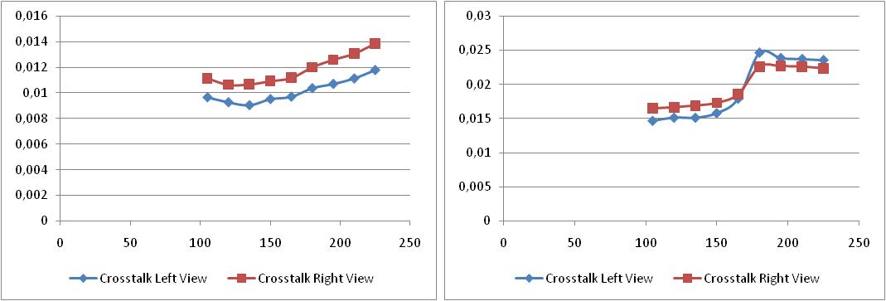
Crosstalk (Y=0), measurement 2 (with Hagner)
Center of the display
Center bottom of the display

Slide 19


Finally we would like thank our sponsor:
  Acreo’s work was supported by VINNOVA (The Swedish Governmental Agency for Innovation Systems), TCO Development and Intertek Semko
Thank you

