Slide 1

QART Update
Carolyn Ford (ITS-NTIA)
Mikołaj Leszczuk (AGH)

Slide 2
Organizations (* – Co-Chairs)
Abbreviation | Name | Test-Plan? | Tests? | Footage? | In Atlanta?
NTIA* | National Telecommunications and Information Administration | Contributed | Done & planned | Provided & planned | Yes
AGH* | AGH University of Science and Technology | Contributed | Done & planned | Provided & planned | Yes
GUT | Gdansk University of Technology | Contributed | Planned | Provided & planned | No
PUT | Poznan University of Technology | - | Planned | Planned | No
GHP | Polish Headquarters of Police | - | Planned | Planned | No
FOI | Swedish Defence Research Agency | - | Planned | Planned | No
PSNI | Police Service of Northern Ireland | - | Planned | Planned | No
QMUL | Queen Mary, University of London | - | Planned | Planned | No
IBBT | Ghent University | - | - | Planned | Yes
IRCCyN | L'Institut de Recherche en Communications et Cybernétique de Nantes | - | ? | ? | Yes
DT | Deutsche Telecom | - | ? | ? | Yes
Yonsei | Yonsei University | - | - | - | Yes
Axis | Axis Communications | - | - | - | No
March | March Networks | - | Planned | - | No
VQiPS | Other VQiPS contributors | - | Planned | Yes | Some

Slide 3
Organizations (* – Co-Chairs)
Abbreviation | Name | Test-Plan? | Tests? | Footage? | Standardization? | In Atlanta?
NTIA* | National Telecommunications and Information Administration | Contributed | Done & planned | Provided & planned | ASIS/SIA & EU | Yes
AGH* | AGH University of Science and Technology | Contributed | Done & planned | Provided & planned | EU | Yes
GUT | Gdansk University of Technology | Contributed | Planned | Provided & planned | EU | No
PUT | Poznan University of Technology | - | Planned | Planned | EU | No
GHP | Polish Headquarters of Police | - | Planned | Planned | EU | No
FOI | Swedish Defence Research Agency | - | Planned | Planned | EU | No
PSNI | Police Service of Northern Ireland | - | Planned | Planned | EU | No
QMUL | Queen Mary, University of London | - | Planned | Planned | EU | No
IBBT | Ghent University | - | - | Planned | ? | Yes
IRCCyN | L'Institut de Recherche en Communications et Cybernétique de Nantes | - | ? | ? | ? | Yes
DT | Deutsche Telecom | - | ? | ? | ? | Yes
Yonsei | Yonsei University | - | - | - | ? | Yes
Axis | Axis Communications | - | - | - | ASIS/SIA | No
March | March Networks | - | Planned | - | ASIS/SIA | No
VQiPS | Other VQiPS contributors | - | Planned | Yes | ASIS/SIA | Some

Slide 4

QART Test-Plan
Edits mainly in „Subjective Rating Tests”
Task-based video tests described
  Resolution measurement (NTIA)
  Object recognition (NTIA)
  Vehicle recognition (AGH)
  HCI – Human Computer Interaction (GUT)
Expected
  More tests
  Clustering into Generalized Used Classes (GUC)
Collaboratively edited:

Slide 5
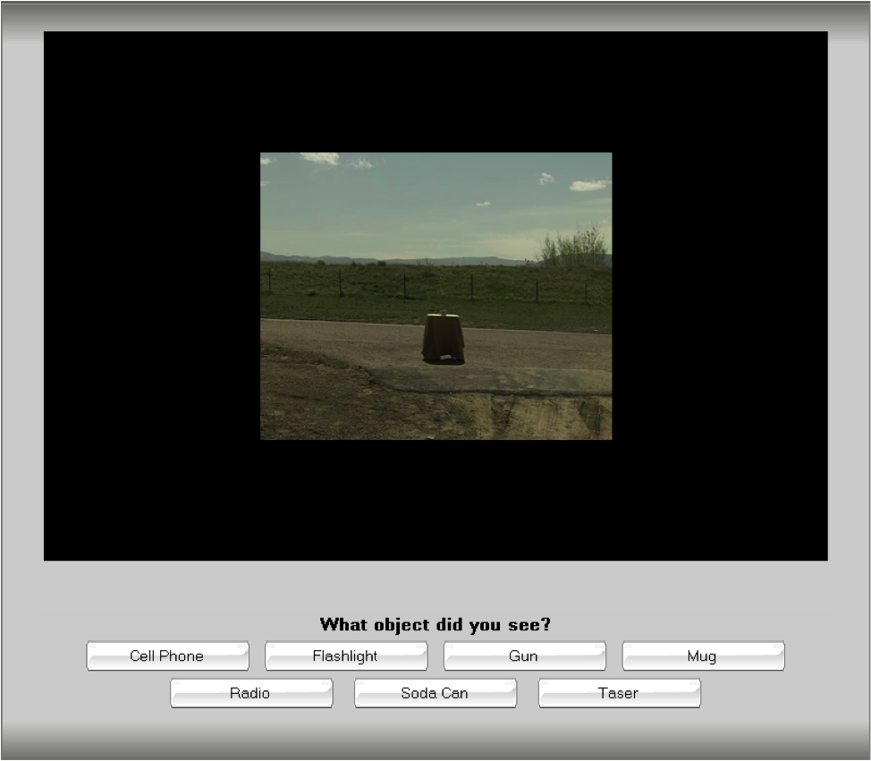
Human Object Recognition Tests
(Task-Based Test Method)

Slide 6
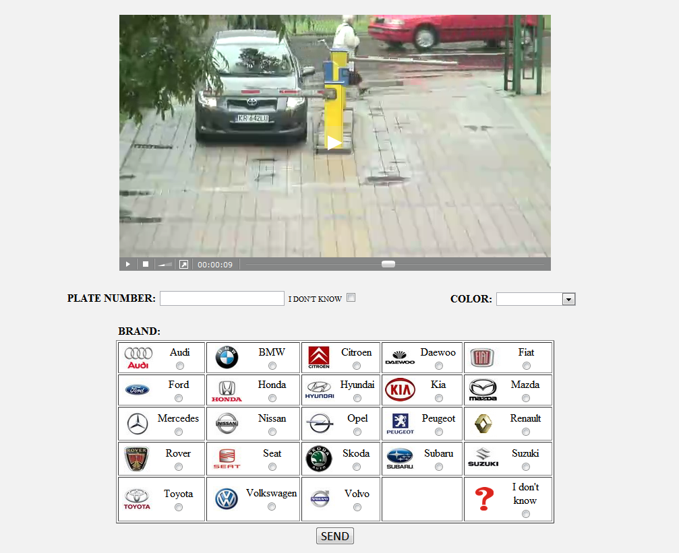
Car Recognition Test

Slide 7

Subject Sometimes Put to Sleep
Methodology to remove subjects

Slide 8
Boston VQiPS Meeting
Draft of video quality standards proposal for CCTV/security applications
Plans for next tests:
  Experiment of remote/distributed testing
  Plan for fire/smoke reading test method
  Plan for forensic analyst test method

