Slide 1
Proposed Task-Based VQEG Project
Carolyn Ford, Mikołaj Leszczuk

Slide 2
Monitoring of Public Safety using Transmission and Analysis of Video Content
Gains on importance of overall increase in crime and terrorism
Attack on WTC
Attack on public transport in London
Attack on public transport in Madrid
Other public urban areas
Airports
Stations
Mass events
Intersections
Traffic

Slide 3
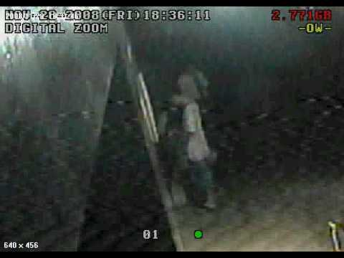
Motivation

Slide 4
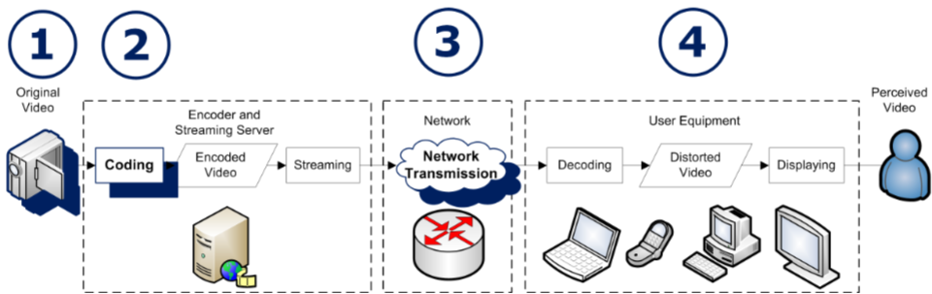
Unacceptable video quality?
How it happens?
Acquisition: noise, out-of-focus, over/under-exposure
Compression and processing: throughput scaling and watermarking-related artifacts
Network transmission: artifacts related to packet loss
Scenario-specific parameters: provided with user’s responses

Slide 5
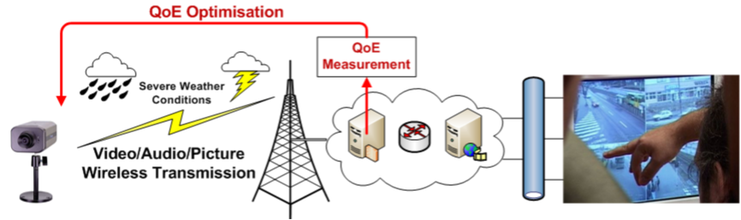
Why video quality assessment and optimization is required?
Optimization is necessary to assure acceptable video quality
  ”Acceptable” = good enough to detect e.g. face or car number
First step towards optimization is detection of degradation roots:
  What is the main problem along video delivery chain?
  How can it be compensated / eliminated?
Reliable and complete video quality watching system is needed!

Slide 6
Subjective video quality assessment methods for recognition tasks (1/2)
Subjective assessment methods for evaluating the quality of one-way video used for target recognition tasks
“Target” referring to something in the video that the viewer needs to identify, e.g.:
  face,
  object, or
  numbers, ...

Slide 7
Subjective video quality assessment methods for recognition tasks (2/2)
TRV (Target Recognition Video) –used to accomplish specific goal through ability to recognize targets
Three categories of target:
  Human identification (including facial recognition),
  Object identification,
  Alphanumeric identification, ...

Slide 8
VQiPS Group
VQiPS: Video Quality in Public Safety
Activities:
Common Video Definitions
User Requirements
Standards Development
Funded by: U.S. Department of Homeland Security
Operated by: U.S. National Institute of Standards and Technology
Notes:
Video Quality in Public Safety Working Group
About Video Quality in Public Safety
For emergency responders using incident video services, a clear picture can mean the difference between life and death. Video applications are quickly emerging as an essential component in the effort to create seamless communications among emergency responders. As video technology has evolved, the array of options for public safety practitioners has grown and the interoperability challenges have become increasingly complex. Communication between practitioners and manufacturers is often unclear, making it even more difficult for public safety agencies to get the best equipment for their particular requirements.
Background
In 2005, researchers at the Institute for Telecommunication Sciences (ITS) began conducting subjective testing of individual public safety applications and convened panels of recorded video experts to study the outcomes of those tests. ITS also researched various video quality and interoperability efforts and found that several organizations and agencies were developing their own guidelines aimed at improving the quality and interoperability of video in public safety. Federal partners saw the value in bringing the leaders of these projects together with other public safety practitioners and manufacturers to discuss common challenges and lay the groundwork for the development of solutions.
Video Quality in Public Safety Conference
The U.S. Department of Homeland Security’s Office for Interoperability and Compatibility, in partnership with the Public Safety Communications Research program, hosted the first Video Quality in Public Safety (VQiPS) conference in early February 2009.
The conference provided stakeholders with the opportunity to discuss their successes and the challenges related to video quality and interoperability. During the conference, attendees from each public safety discipline—law, fire, and emergency medical services—volunteered to participate in the VQiPS Working Group.
Video Quality in Public Safety Working Group
The VQiPS Working Group provides a forum in which stakeholders can educate each other on their work, and collaborate on next steps and future solutions, thereby reducing the duplication of efforts. The VQiPS Working Group consists of public safety practitioners at the local and state levels; Federal partners; representatives from academia and non-profit entities; and manufacturers.
The initiatives that the Group is undertaking include developing a user requirements guide that will educate end users on the appropriate video systems for their needs, creating a collective glossary of video terms, forming use cases for requirement needs, researching and documenting gaps in existing standards, and recommending video specifications. Each initiative will be addressed through separate Task Groups under the larger Working Group. The Working Group’s efforts will educate users so they can make the technology investments and practical decisions necessary to keep the Nation’s communities safe and protected.
Links
VQiPS Web Site
VQiPS Fact Sheet
VQiPS Conference Report

Slide 9



VQiPS Project Overview
Big picture: What is the Overall Goal?
  Match User Requirements to applicable standards
  Determine need for new standards work
End User
Generalized Use Class
Appropriate Specifications
ANSI
ASIC
ITU
NIST
“What kind of system do I need?”
“Please answer this series of simple questions about your application”

Slide 10
VQiPS Framework
Can be used to:
  Establish a model of the relationship between size, motion and lighting and visual intelligibility
  Design experiments for determining performance specifications for any piece of equipment in a video system, or for an end-to-end system
  Test performance/conformance of potential purchases
  Test performance of new technology

Slide 11
The INDECT Integrated Project (FP7-SEC)
The Main INDECT Objectives
To develop a platform for intelligent processing of information for detection of threats and recognition of criminal behaviour
To develop a new type of search engine for multimedia contents, based on watermarking technology
To develop a prototype for intelligent system providing techniques and tools for observation and detection of mobile objects
To develop a new tools for Internet data analysis (to detect criminal activities and threats in computer communication network)

Slide 12
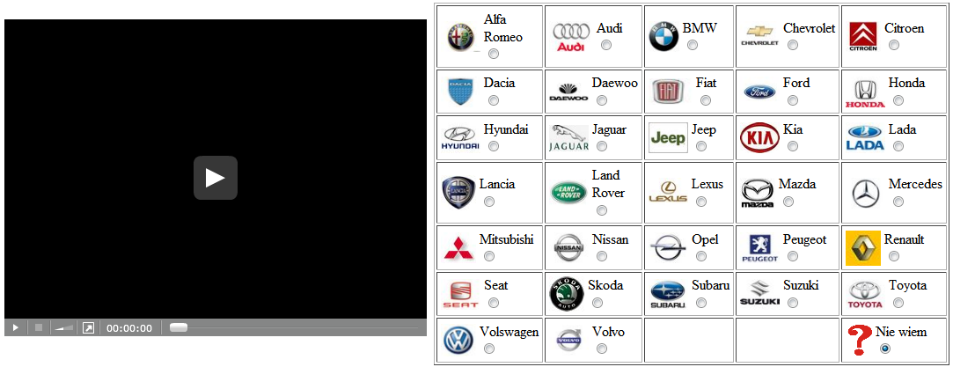
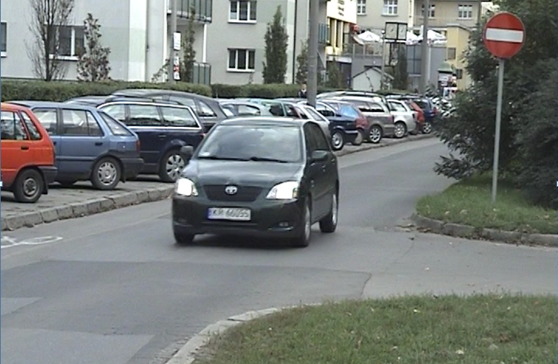
Video Quality Optimization
Subjective experiment:
Web interface
Tasks:
  Identify vehicle color
  Identify vehicle brand
  Read vehicle registration plate
Goals:
Video quality optimization by codec parameters adjustment
Human recognition optimization
Machine recognition optimization

Slide 13
Questions and Summaries
Questions:
  What video evaluation scenarios should be considered?
  What kind of recognition tasks should be considered?
  What kinds of video should be evaluated?
  What about computer vision recognition?
  Who can provide subjects (viewers, testers)?
Any other ideas, thoughts?

Slide 14

Thank you for Your Attention!

