Slide 1

AGH and Lancaster University

Slide 2
Non-intrusive network based assessment
Assess based on visibility of individual packet loss
  Frame level: Frame dependency, GoP
  MB level: Number of affected MBs/slices
  Content level: characteristics of content
Assess based on network QoS
  Network level: Packet loss ratio
  Content level: characteristics of content

Slide 3
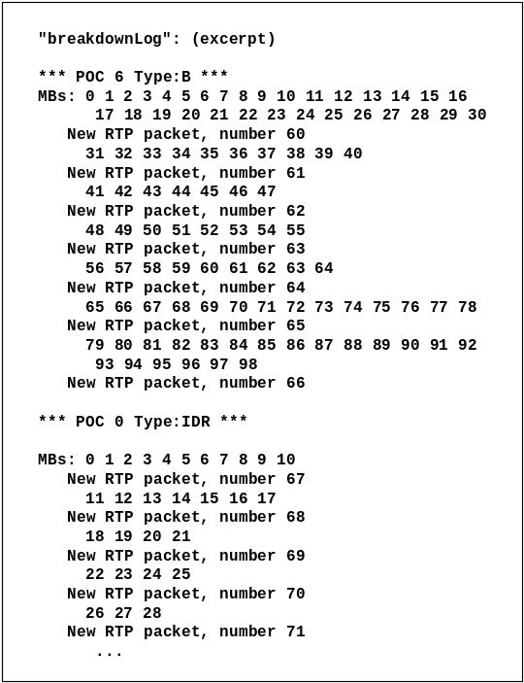
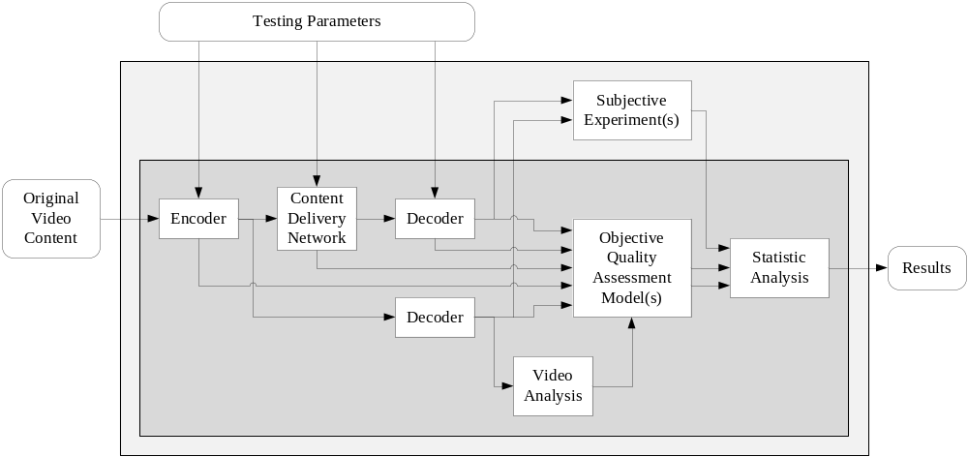
Bitstream analyser
There is a tool to calibrate packet loss with its location in the video stream.
However, this is done offline and its based on JM reference software only.
M. Mu, A. Mauthe, J. Casson, F. Garcia, "LA1 TestBed: Evaluation Testbed to Assess the Impact of Network Impairments on Video Quality“, The 5th International Conference on Testbeds and Research Infrastructures for the Development of Networks and Communities (TRIDENTCOM'09), Washington D.C., USA

Slide 4
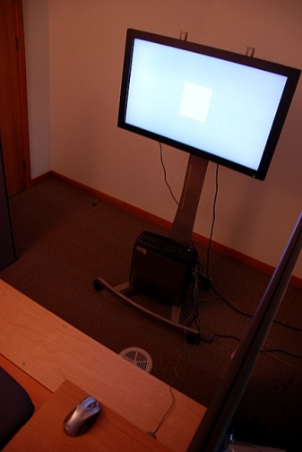
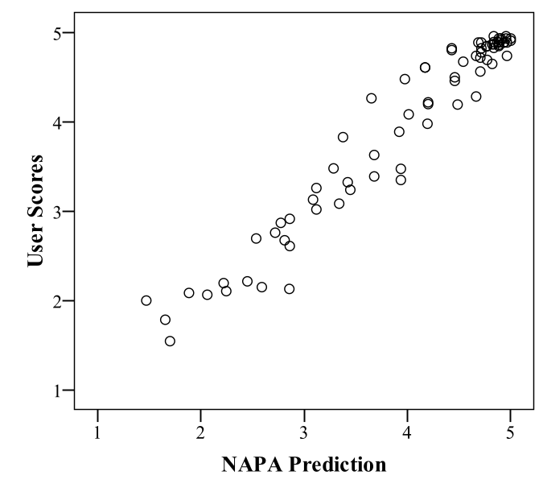
QA results: Artifact prediction
The results show that a bit-stream model can achieve promising prediction of QoE based on network, frame and content-level information. this is a result from previous test in ULANC.
Prediction
Related work:
M. Mu, A. Mauthe, F. Garcia, "A Utility-based QoS Model for Emerging Multimedia Applications“, 1st IEEE Future Multimedia Networking Workshop, UK
M. Mu, R. Gostner, A. Mauthe , F. Garcia, G. Tyson, "Visibility of Individual Packet Loss on H.264 Encoded Video Stream – A User Study on the Impact of Packet Loss on Perceived Video Quality“, Sixteenth Annual Multimedia Computing and Networking (MMCN'09), San Jose, California, USA

Slide 5
No-Reference Metrics for H.264 compression
Quantization domain
  Blockiness
    Comparison of the cross-correlation of pixels inside and outside coding blocks
  Flickering
    Two-state model for coding blocks ("Update" and "No Update" states)
    Metric based on number of state changes per second calculated for each coding block
  Combination
    Linear combination of two above
Spatial domain
  Metric based on spatial resolution + spatial and temporal activity
Temporal domain
  Metric based on FPS + spatial and temporal activity

Slide 6
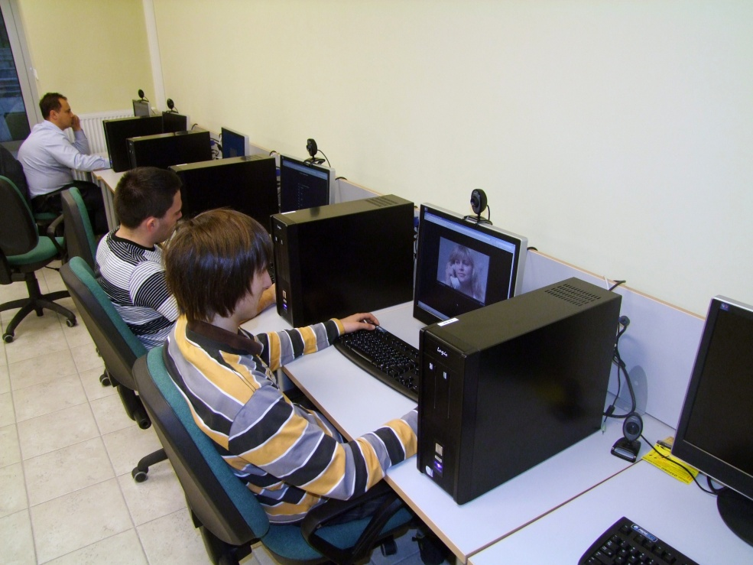
Subjective experiments #1
Methodology
  ACR-HR (Absolute Category Rating with Hidden Reference)
  11-point quality scale
Testset
  4 sequences, diverse in terms of content, spatial (details) and temporal activity (motion): #16 Betes, #18 Autumn, #19 Football, #21 Susie
  Single scaling only (compression or FPS scaling or resolution domain)
Subjects
  100 students
Models
  MOS(blockiness) , R^2
  MOS(flickering), R^2
  MOS(combination) , R^2
  MOS(FPS) , R^2
  MOS(resolution) , R^2

Slide 7
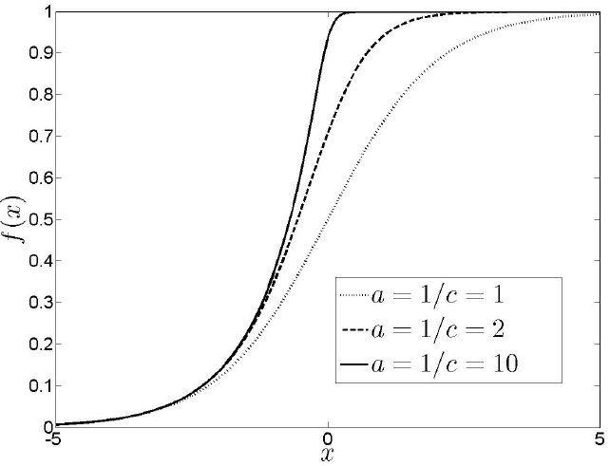
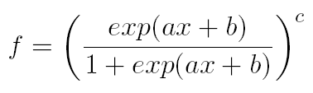
Regression analysis
Asymmetric logit function
Correlation R^2
  Blockiness 0.74
  Flickering 0.89
  Combination 0.934

Slide 8
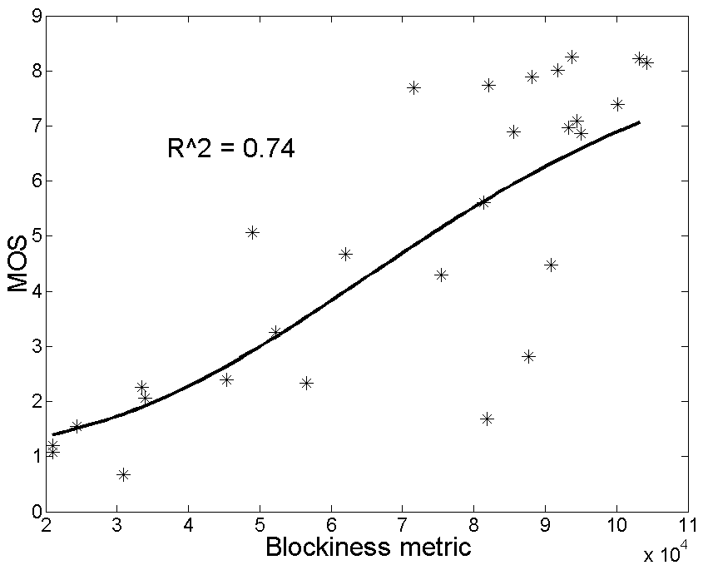
Blockiness

Slide 9
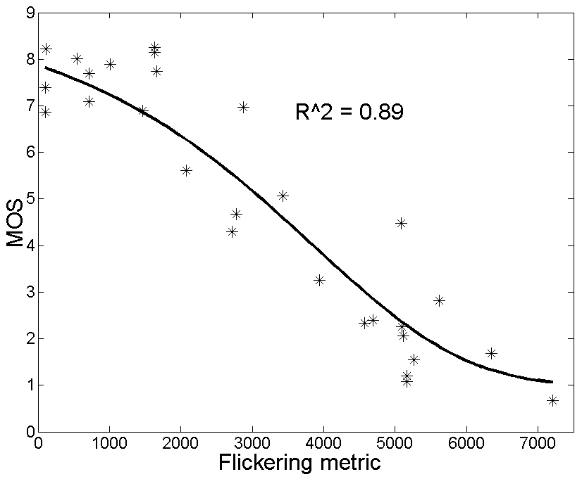
Flickering

Slide 10
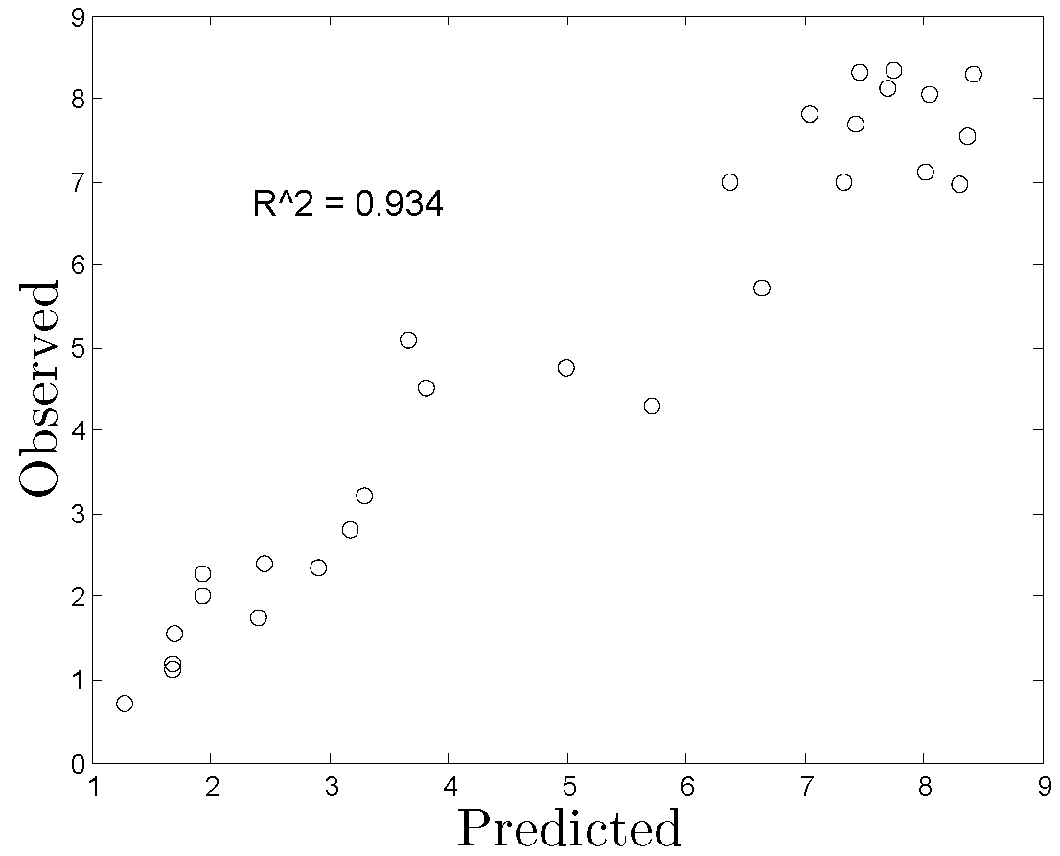
Combination (blockiness + flickering)

Slide 11
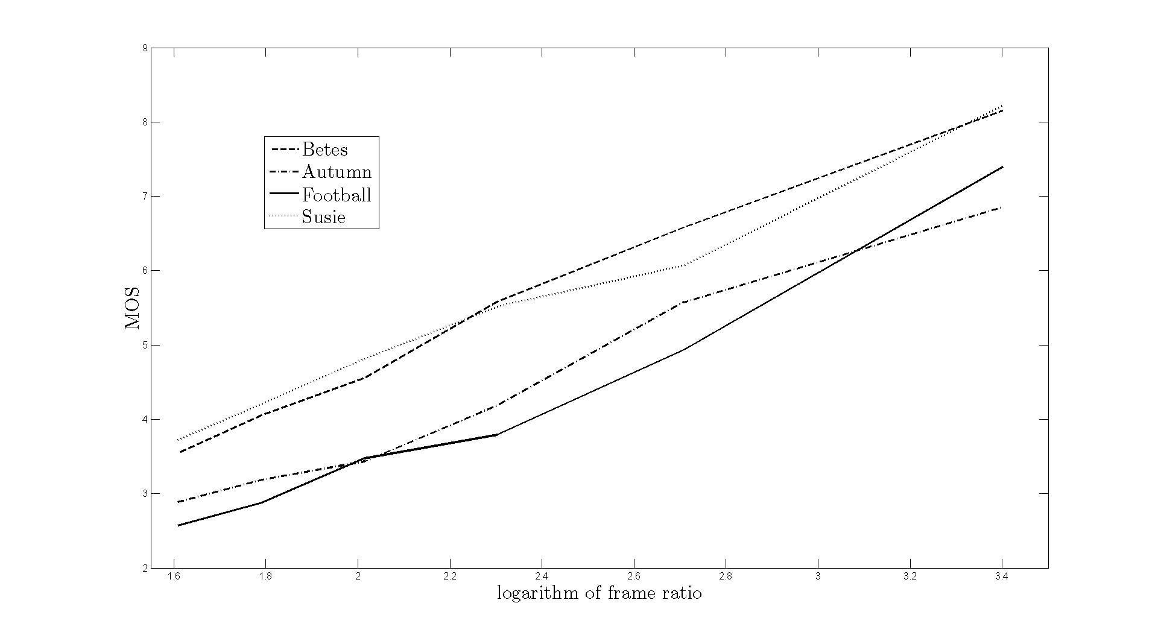
FPS

Slide 12
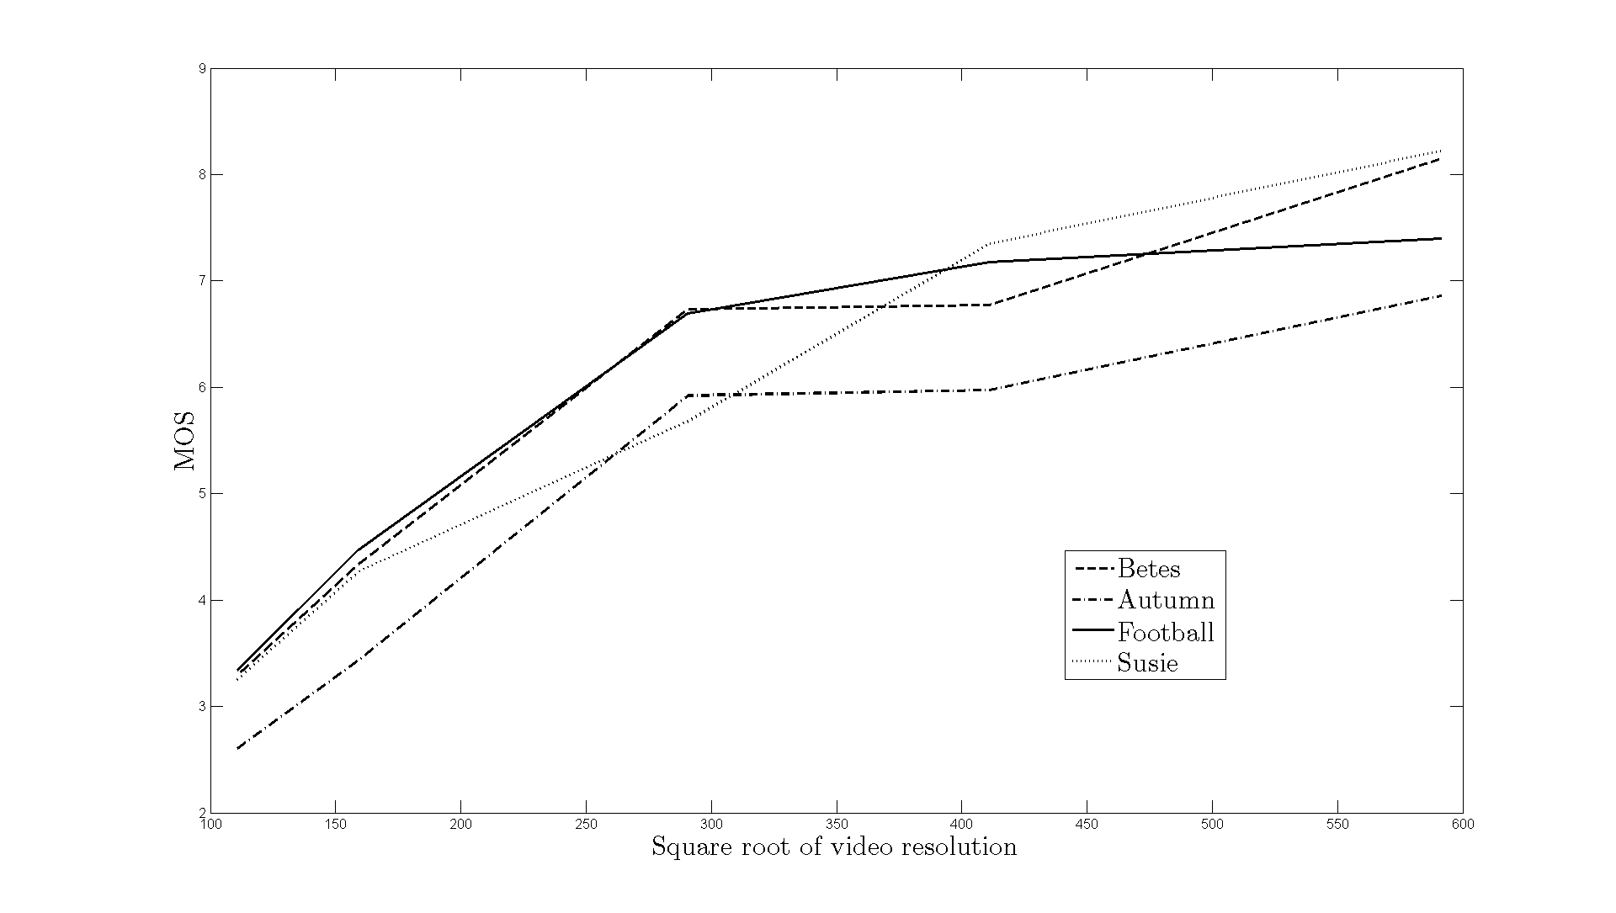
Resolution

Slide 13
GLZ analysis
Considering categorical or nominal data describing a movie
For which movies the MOS values are statistically different
The subjects’ answers analysis, some of them are statistically the same

Slide 14
Subjective experiments #2
Methodology
  ACR-HR (Absolute Category Rating with Hidden Reference)
  11-point quality scale
Testset
  10 sequences
  Single parameters (compression, FPS, resolution, PLR)
  Cross-domain scaling (compression+FPS+resolution)
Subjects
  60 students
Models
  To be done…
    Joint metric for H.264 scaling (compression, spatial and temporal domains)
    PLR

