Slide 1

Generalized Linear Model
Lucjan Janowski
Faculty of Electrical Engineering, Automatics, Computer Science and Electronics
Department of Telecommunications

Slide 2
Agenda
What is AGH doing?
A dog problem
A solution – variable types
How can we model ordinal variables
Conclusions
Rasch model?

Slide 3




Our group
Objective Metric
Piotr Romaniak
Mikolaj Leszczuk
The subjective answers’ analysis
Lucjan Janowski
Zdzislaw Papir

Slide 4
The subjective answers’ analysis
Removing not relevant testers. We are using specific latent class model called Rasch model. It gives much more information than only who is not relevant
Using asymmetric logit function to model 11 point scale. We use bootstrap method to compute confidence intervals.
Using Generalized linear model (GLZ) to analyze 5 point scale

Slide 5

When statistics starts to be tricky
Statistically speaking me and my dog have three legs each …
Is it an argument that statistics does not work?
Maybe it is a correct result. We could wonder how many tracks we will see
What kind of information are we looking for?

Slide 6


Random variable types
Not all features that an object has can be described by numbers
A person can be described by numerous different features
  Weight and height are interval variables (more precisely ratio variables)
  Education and socio economic class
  are ordinal variables
  Sex and religion are nominal
  variables

Slide 7
The consequences
We can ask what is the average weight of people in the room. For interval variables we can use any statistics we would like
We can ask how many people have PhD degree, how many people have finished at least high school. We cannot say what is the average education level. For ordinal variables we can determine probability and p-percentile
We can ask how many people are Christian but we cannot say how many people are at least Christian. For nominal variables we can determine probability only

Slide 8


Ordinal variables
We know order but NOT distance between different values
Car size (Economy, Compact, Mid size, Standard…), quality (Excellent, Good, Fair, Poor, Bad)
We do not know distance between any two answers therefore we are limited to:
  Median
  p-percentile
  probability

Slide 9
Why distances are not equal?
We observed two extreme behaviors
  Very large distance between extreme answers
  Very small probability of non extreme answers
5
4
3
2
1
5
4
3
2
1
Notes:
Przyklad ze skala opisana tylko na koncach, excelent – bad I odpowiedz jest 73 lub 43 – co to znaczy ??

Slide 10
Why do we use subjective tests?
Peter Reichl, Joachim Fabini, Marco Happenhofer, Christoph Egger “From QoS to QoX: A Charging Perspective”
From QoS definition:
“the collective effect of service performance which determines the degree of satisfaction of a user of the service"
“QoE has been defined as an extension of the traditional QoS in the sense that QoE provides information regarding the delivered services from an end-user point of view.”
We need a user to find out which kind of distortions are seen and what is theirs level
We should focus on user not distortions themselves, and we should choose such a statistical tool that helps users’ answers analysis not distortions’ descriptions

Slide 11
How people describe things
We make categories, like a service is good, bad, …
In daily life we use numbers very rarely
We often speak about quality in daily life
The distances between different quality descriptions are not equal and are not the same for different people
This is an ordinal variable definition – so we should use statistical tool that models ordinal variables

Slide 12
Linear regression assumptions
Opinion score is composed of two factors, a deterministic being a function of objective metric and a random component
Knowing the deterministic part we can predict the opinion score value with maximum accuracy

Slide 13
A function type
Linear
Polynomial
Non linear, for example

Slide 14
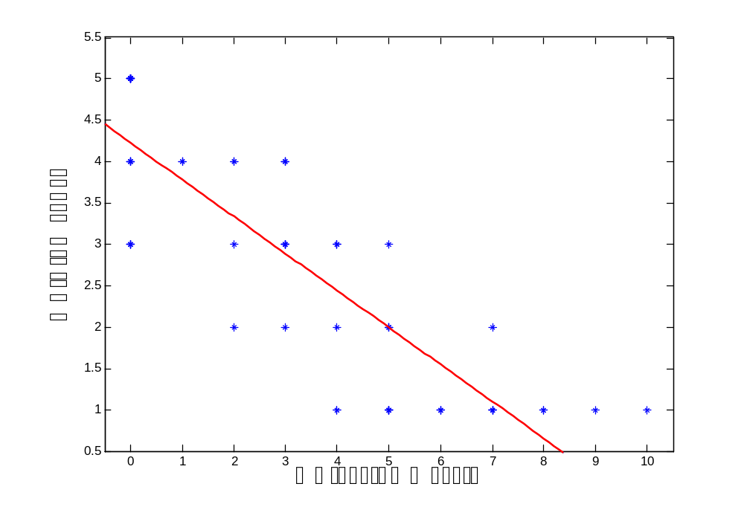
Distance
r_{j}
r_{i}
r_{k}

Slide 15
The least squares function
Easy and intuitive r_{i} definition
In order to deal with negative values we have
The estimated parameters minimize

Slide 16
Linear regression advantages and disadvantages
Easy to interpret
Unambiguous and fast estimation algorithm
We estimate only the mean value
The residuals should follow normal distribution what is impossible for only 5 MOS answers
For polynomial functions we can obtain any or almost any value, note that testers’ answers are limited to a range (1-5, 0-10, etc.)
Notes:
Unamibigius zapytac czemu proponujacy proponuja TYLKO objective jak na koncu sprzedajemy MOS ????

Slide 17
The problem analysis
Opinion scores are limited
Objective metric can be unlimited or almost unlimited
f(x) is a monotonic function
f(x) can behave differently for high MOS values than for low MOS values
We should find a function that can model all those features and is relatively simple

Slide 18
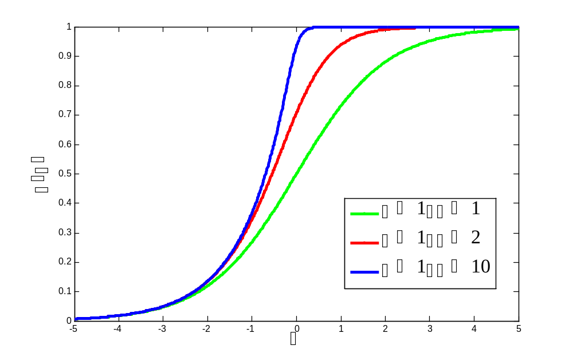
Asymmetric logit function

Slide 19
Exact formula
The formula
We should normalize dependent and independent variables
Note that it is a non linear function therefore a start point is strongly recommended

Slide 20
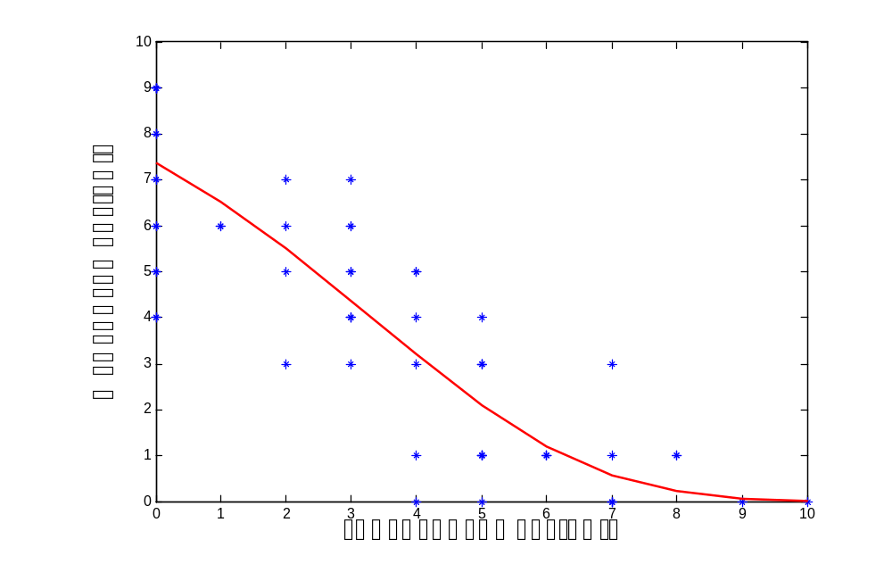
ALF fitting

Slide 21
Matlab fitting functions
‘fittype’ function
  model = fittype('(exp(a*x+b)/(1+exp(a*x+b)))^c','independent','x');
‘fit’ function
  fit(x,y,model)
  fit(x,y,model,’startpoint’,[-1 0 1])
  [a b] = fit(x,y,model,’startpoint’,[-1 0 1])

Slide 22
The least squares methodology conclusions
Advantages
Disadvantages
Simplicity
For large class of functions the solution is unique
Easy to interpret
The residuals should follow normal distribution
We estimate only mean value
For non linear functions the solution is not unique
The confidence intervals cannot be computed easily

Slide 23
Generalized Linear Model (GLZ)
We are able to estimate a dependent variable as a function of independent variables for large class of dependent variable distributions
The methodology is different nevertheless for normal distribution we will obtain almost identical results
Additional output is covariance matrix that makes it possible to use delta method therefore error analysis can be made

Slide 24
Testers’ answers analysis
For 5 points scale described by words and therefore we do not know the distances between answers
Excellent good fair
We should model the probability that a tester will choose particular answer as a function of objective metric

Slide 25
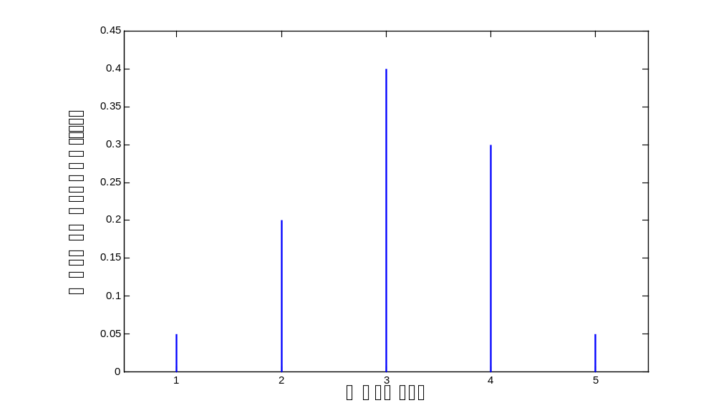
The answers distribution

Slide 26
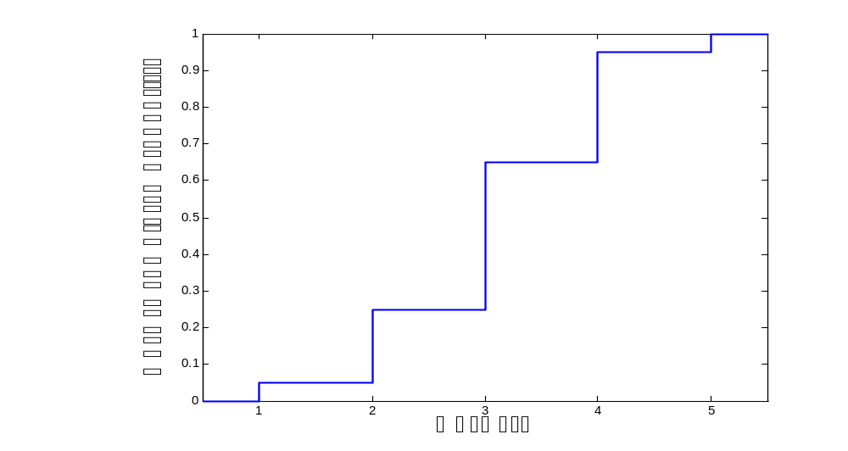
Cumulative distribution function

Slide 27
GLZ estimation
We use a polynomial function of objective metric
We do not model the opinion score directly
f(x) is a link function and for multinomial distribution we use logit function
Note that in the simplest case we have 5 parameters (4 different intercepts and β)

Slide 28
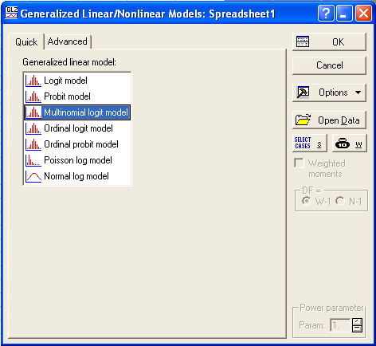
STATISTICA software
Easy to use
Menu Statistics
  Advanced Linear/Nonlinear Models
    Generalized Linear/Nonlinear Models

Slide 29
Information obtained from GLZ model
We know the probability of each answer
We know the variance/covariance matrix
Knowing each probability value makes it possible to compute MOS
We can answer different questions like
  “how many clients really like the service”
  “how many clients will contact call center since the service is poor or worst”

Slide 30
Delta method
For parameters estimated on the basis of MLE (Maximum Likelihood Estimation) we can use delta method
Delta method approximates variance of a function of the model parameters
We can use the obtained variance to compute confidence interval
Since we compute MOS we can focus on MOS confidence interval computation

Slide 31
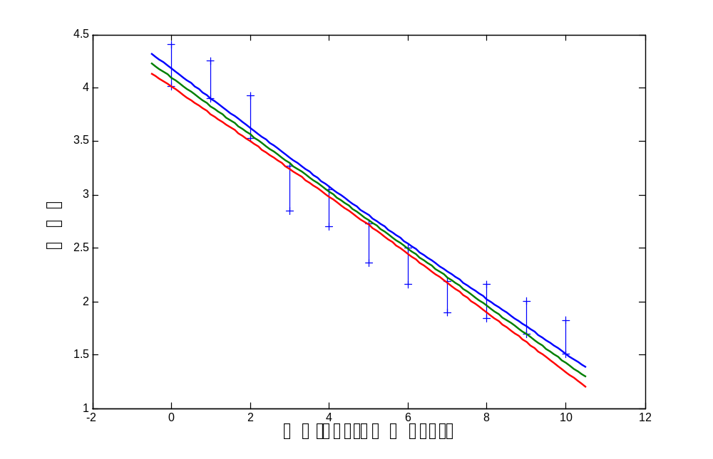
Linear regression confidence interval

Slide 32
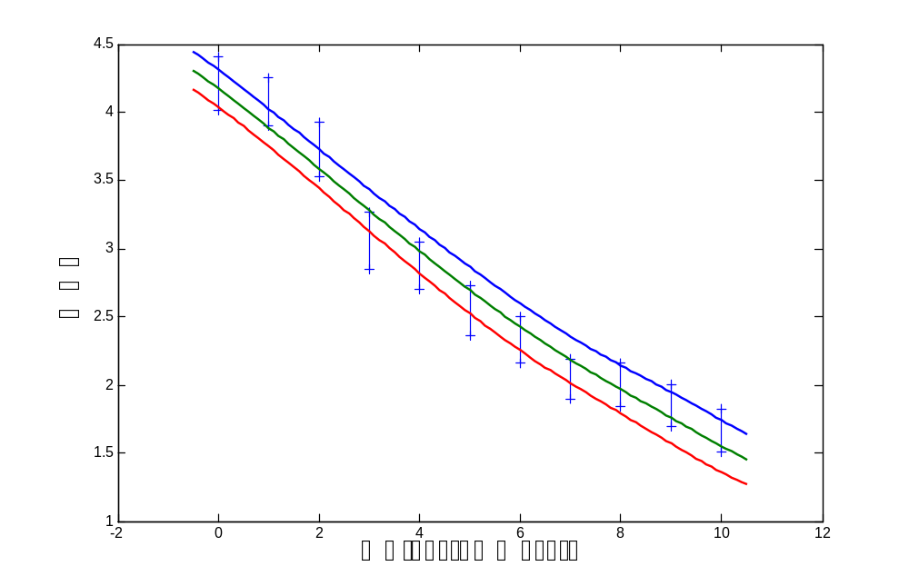
GLZ confidence interval

Slide 33
Conclusions
Linear regression is simple and can show us trends for the mean value only
GLZ supports estimation of each answer probability
We can use each answer probability to find different information not only MOS. Those information are much more understandable since they are based on the test wording
The confidence intervals for GLZ approximation can be computed using delta method and they are more realistic

Slide 34

janowski@kt.agh.edu.pl

Slide 35
Chi^2 Pearson test
For single PVS we have table:
We can decide with particular probability if rows follow the same distribution
ILG | OS
 | 1 | 2 | 3 | 4 | 5
1 | 1 | 5 | 12 | 4 | 3
2 | 0 | 3 | 15 | 5 | 2
3 | 2 | 3 | 10 | 5 | 5
… | … | … | … | … | …
n | 1 | 7 | 10 | 7 | 0

